Slide 1
CUSTOMER RETENTION PROJECT
Mini Sharma

Slide 2
Business Problem Framing
Customer retention is the collection of activities a business uses to increase the number of repeat customers and to increase the profitability of each existing customer.
Customer retention strategies enable you to both provide and extract more value from your existing customer base. You want to ensure the customers you worked so hard to acquire stay with you, have a great customer experience, and continue to get value from your products.
In short, acquisition creates a foundation of customers while your retention strategy is how you build customer relationships and maximize revenue for each one. But how much time and resources should you devote to your retention program.

Slide 3
Conceptual Background of the Domain Problem
A successful business strategy today is not only developing cost-effective and highly targeted ways to reach out the new customers, it is more about keeping the existing customers engaged in the company. It has been acknowledged that bringing in new customers is expensive . Investment in the acquisition of new customers is six times higher than investing in existing customers . Increased performance in customer retention practices, on the other hand, has been found to create five times more impact than a similar amount of discount or cost of the capital, leading into the more profitable customer relationship.
The situation in the market has changed, and the competition has become tougher. Customers have the luxury to choose between many providers. The increasing number of actors in the market has caused a rise in the significance and relevance of customer retention and the planning of a customer retention process is essential in order to achieve the desired level of outcome which is determined in the modern management literature. Although, the development of the customer retention process still is a rather unknown concept due to the lack of research in this specific field. The limited research around the metrics and segments of the customer retention processes has turned out to be the root cause for the problematic implementation of customer retention on companies’ business strategies.
Overall, customer retention has been recognized to be an effective way to lower the maintenance costs per se and yield economic benefits .Progress in retention activities enables the growth in revenue more cost-efficiently than in the acquisition of new customers .

Slide 4
Review of Literature
In today’s challenging economy and competitive business world, retaining their customer base is critical to organization success. If the company doesn’t give their customer some good reason to stay, organization’s competitors will give the customer a reason to leave. Customer retention and customer satisfaction drive profits. It’s far less expensive to cultivate organization existing customer base and sell more service to the customer than it to seek new, single-transaction customers. Most surveys across industries shows that keeping one existing customer is five to seven times more profitable than attracting one new customer. A customer-focused approach among its employees is still not present. In this era of intense competition .it is very important for any service company to understand that merely acquiring customer is not sufficient because there is a direct link between customer retention over time and profitability & growth. Customer retention to a great extent depends on service quality and customer satisfaction. Complaints are natural part of any service activity as mistakes are an unavoidable feature of all human endeavour and thus also of service recovery. Service recovery is the process of putting things right after something goes wrong in the service delivery. Customer retention is the maintenance of continuous trading relationships with customers over the long term. Customer retention is the mirror image of customer defection or chum.

Slide 5
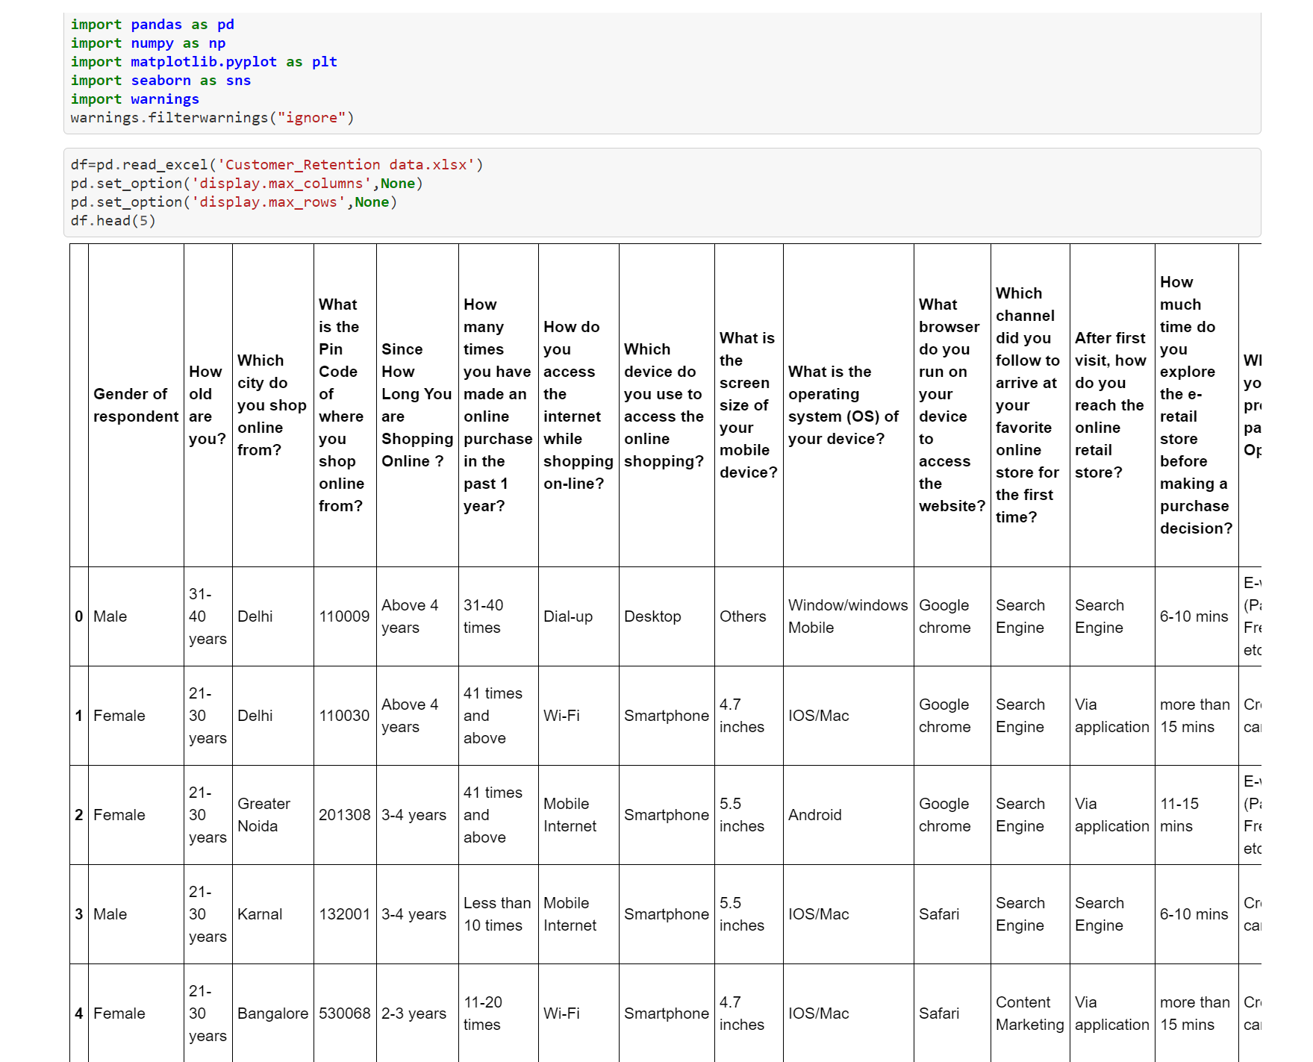
Loading Necessary libraries and CUSTOMER RETENTION dataset

Slide 6
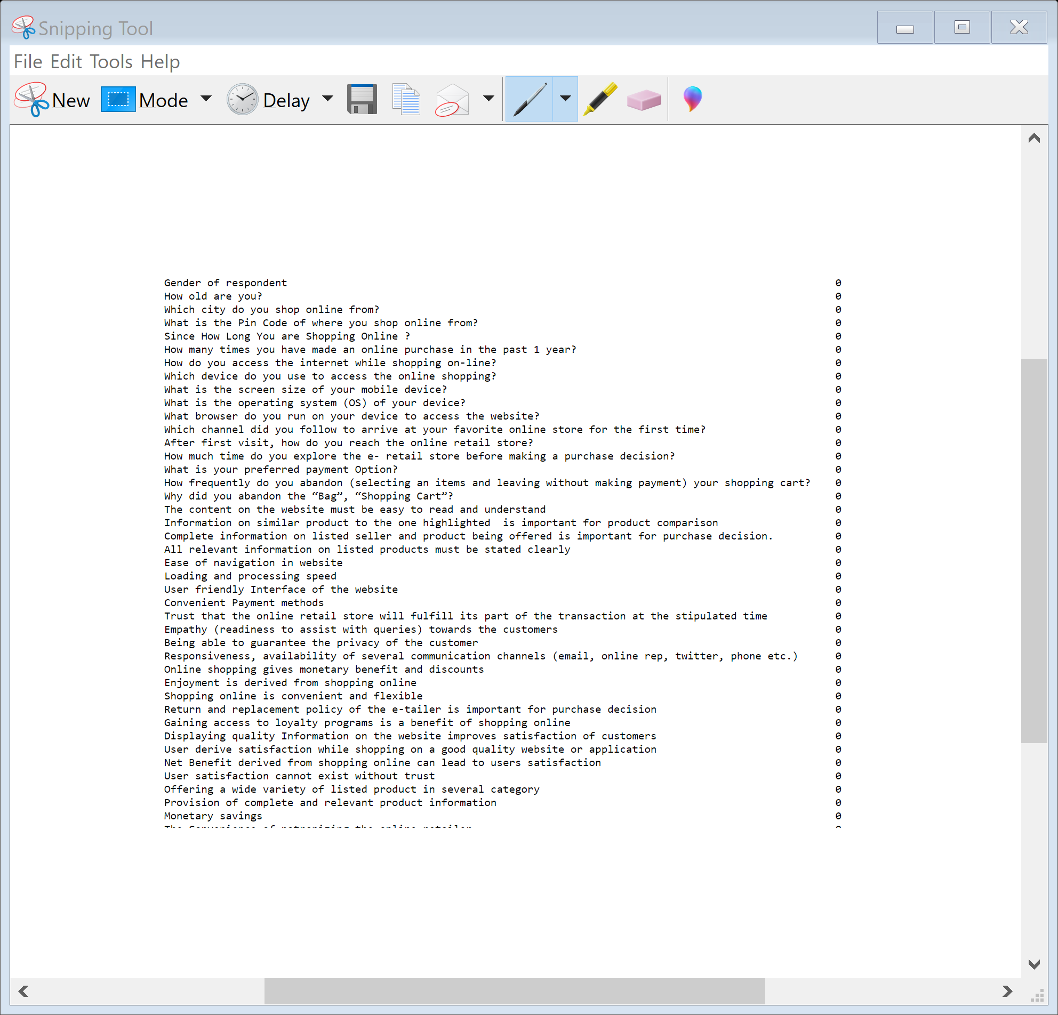
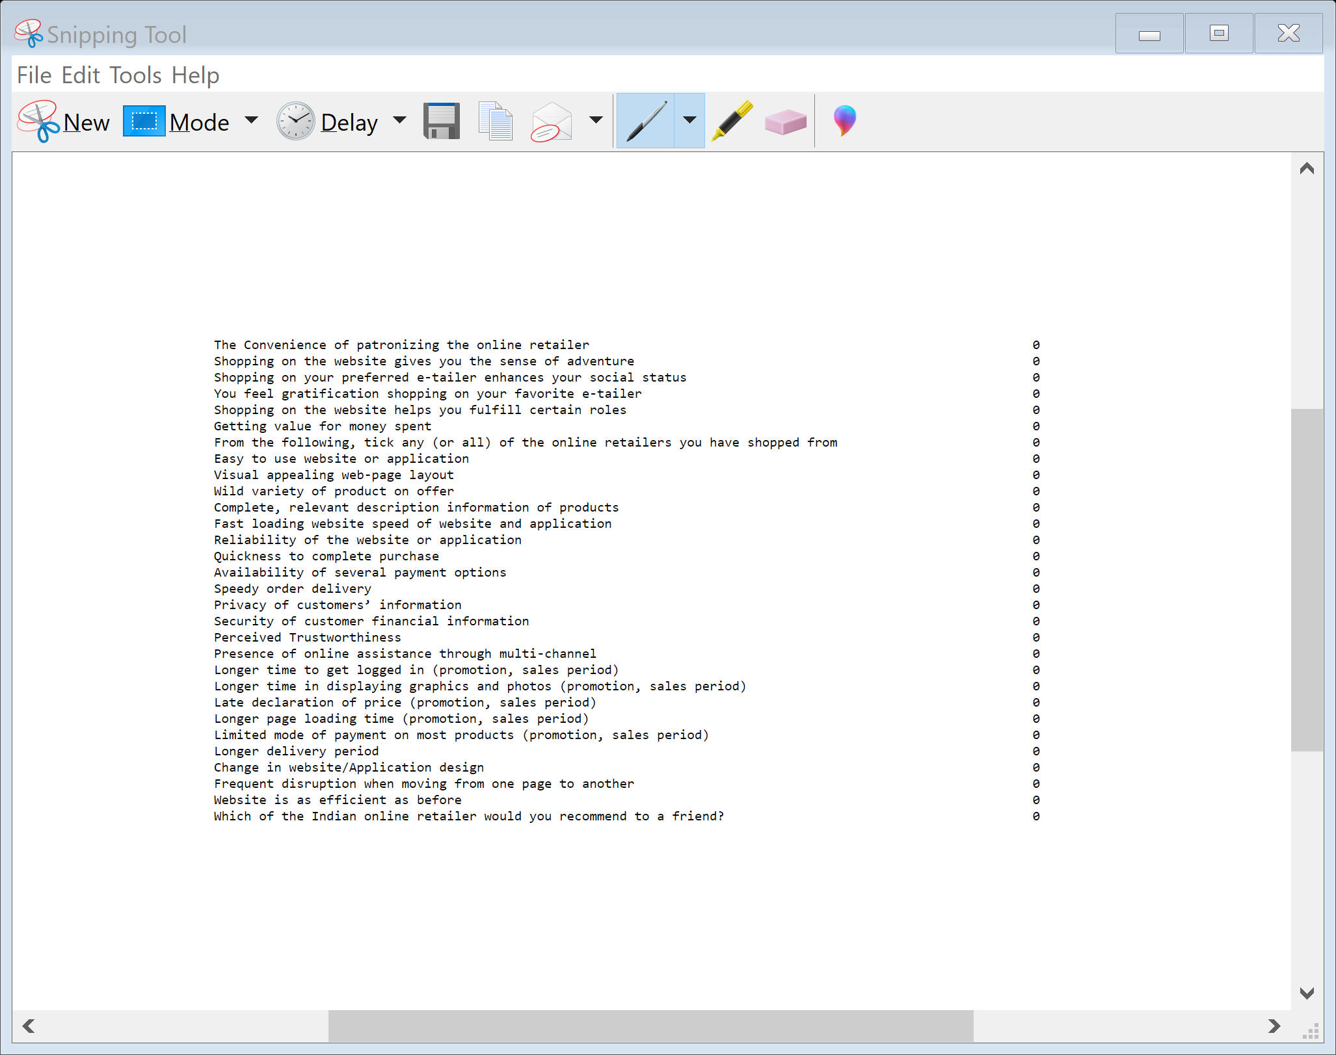
Lets check the null values in the data set
Here we can see that there are no null values present in dataset

Slide 7
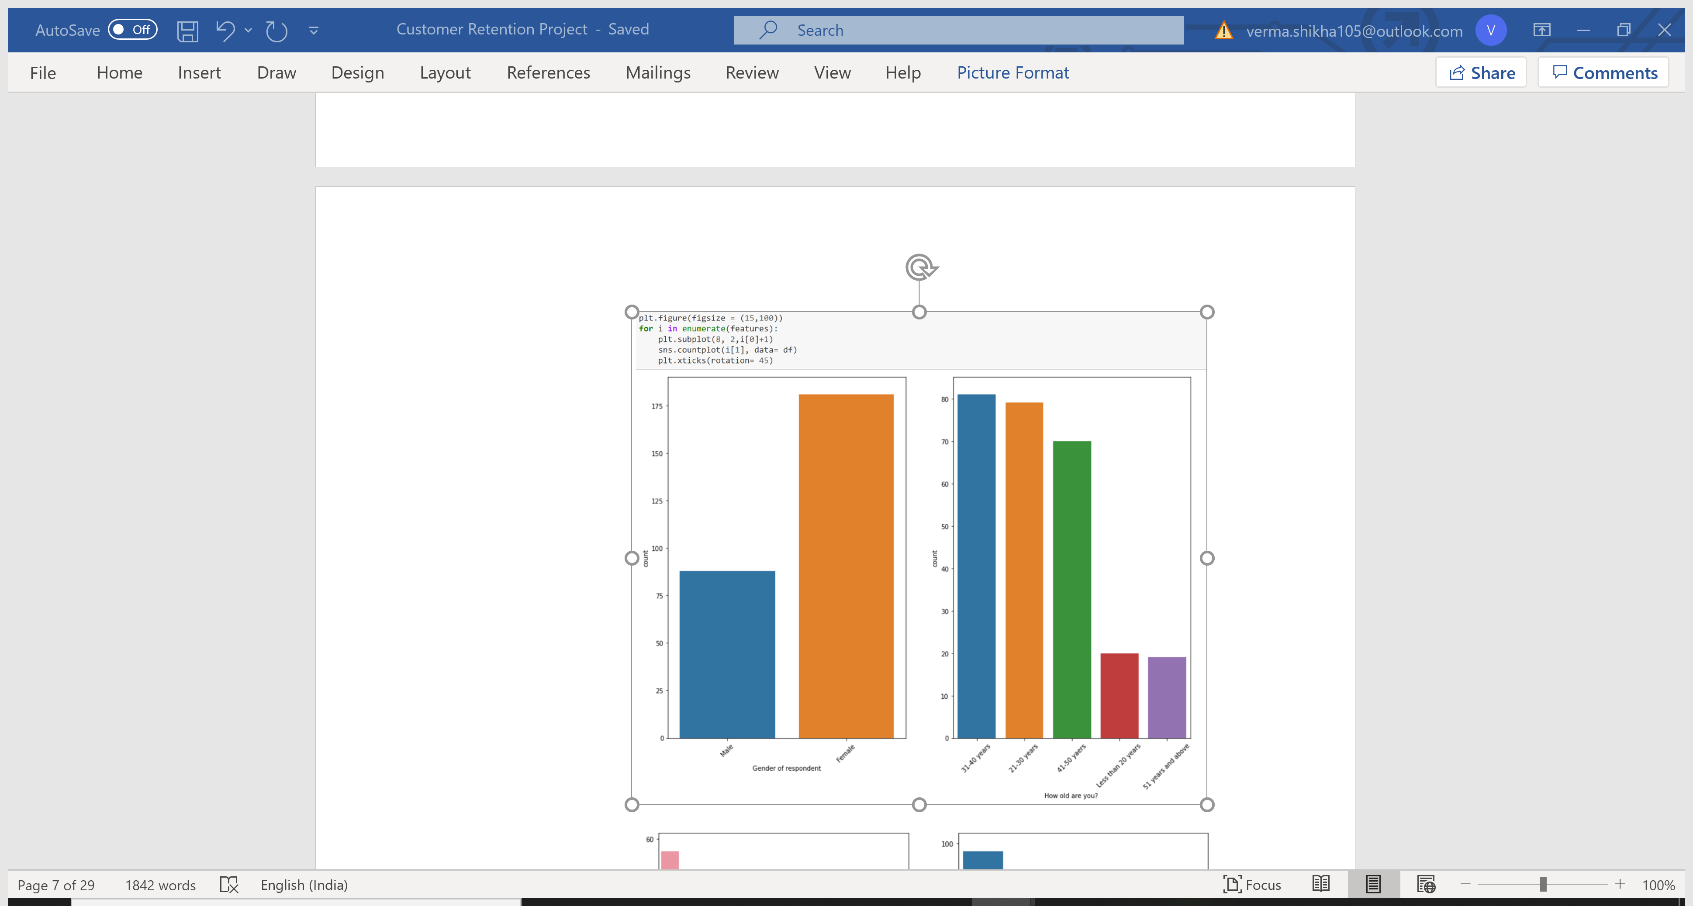
VISUALIZATION
No of female respondents are more than male respondents while doing online shopping.
Customers belonging to age group 21 to 50 are more indulge in online shopping as compared to other age group.

Slide 8
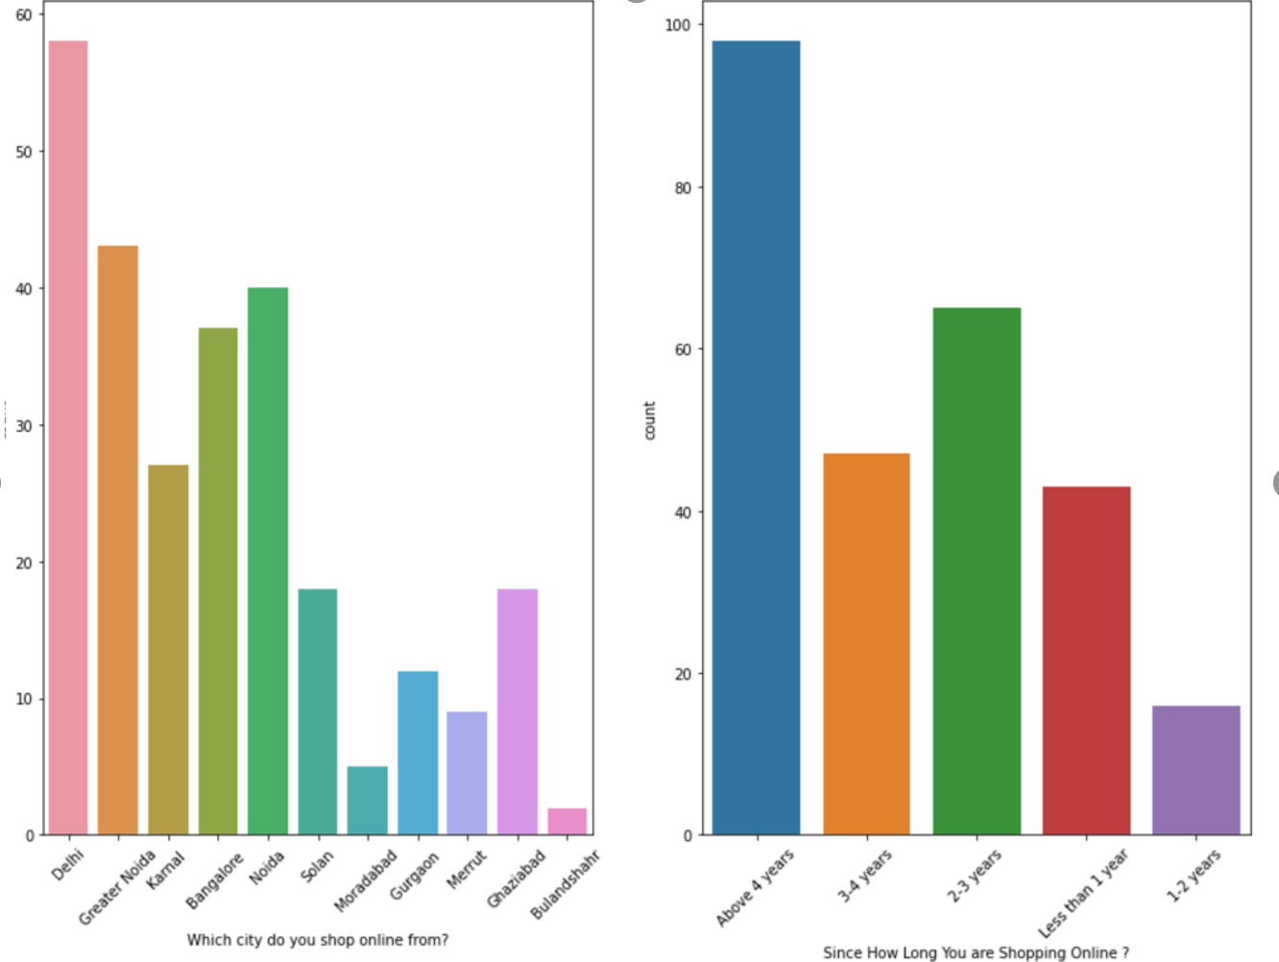
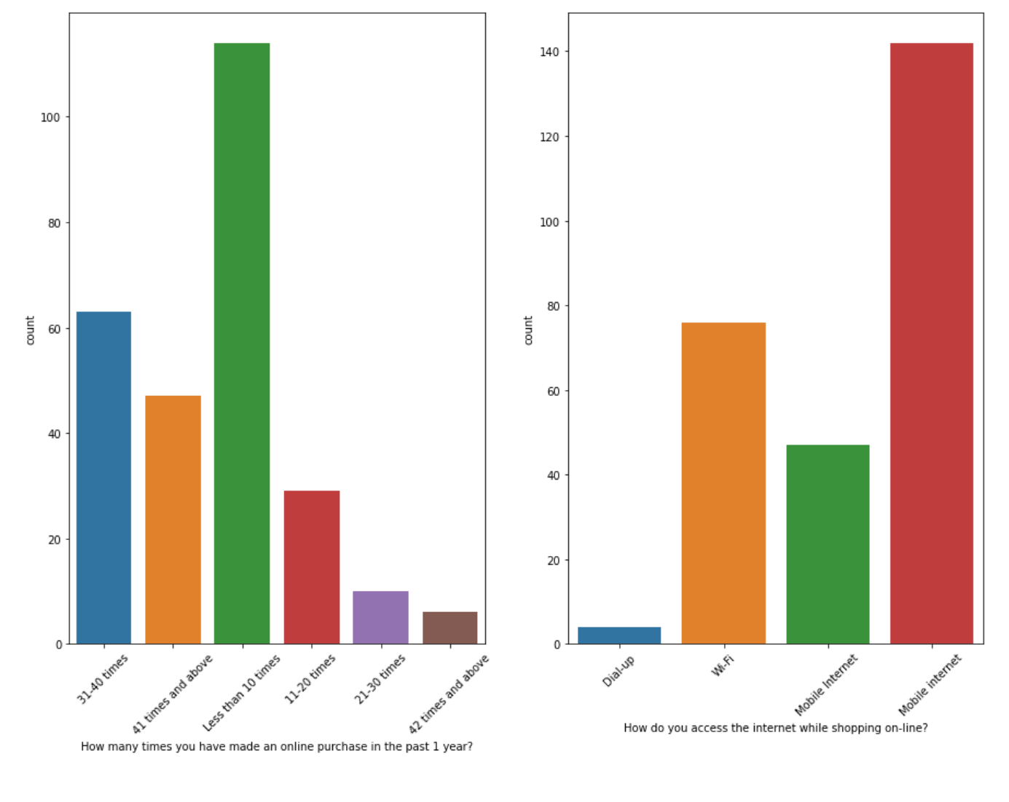
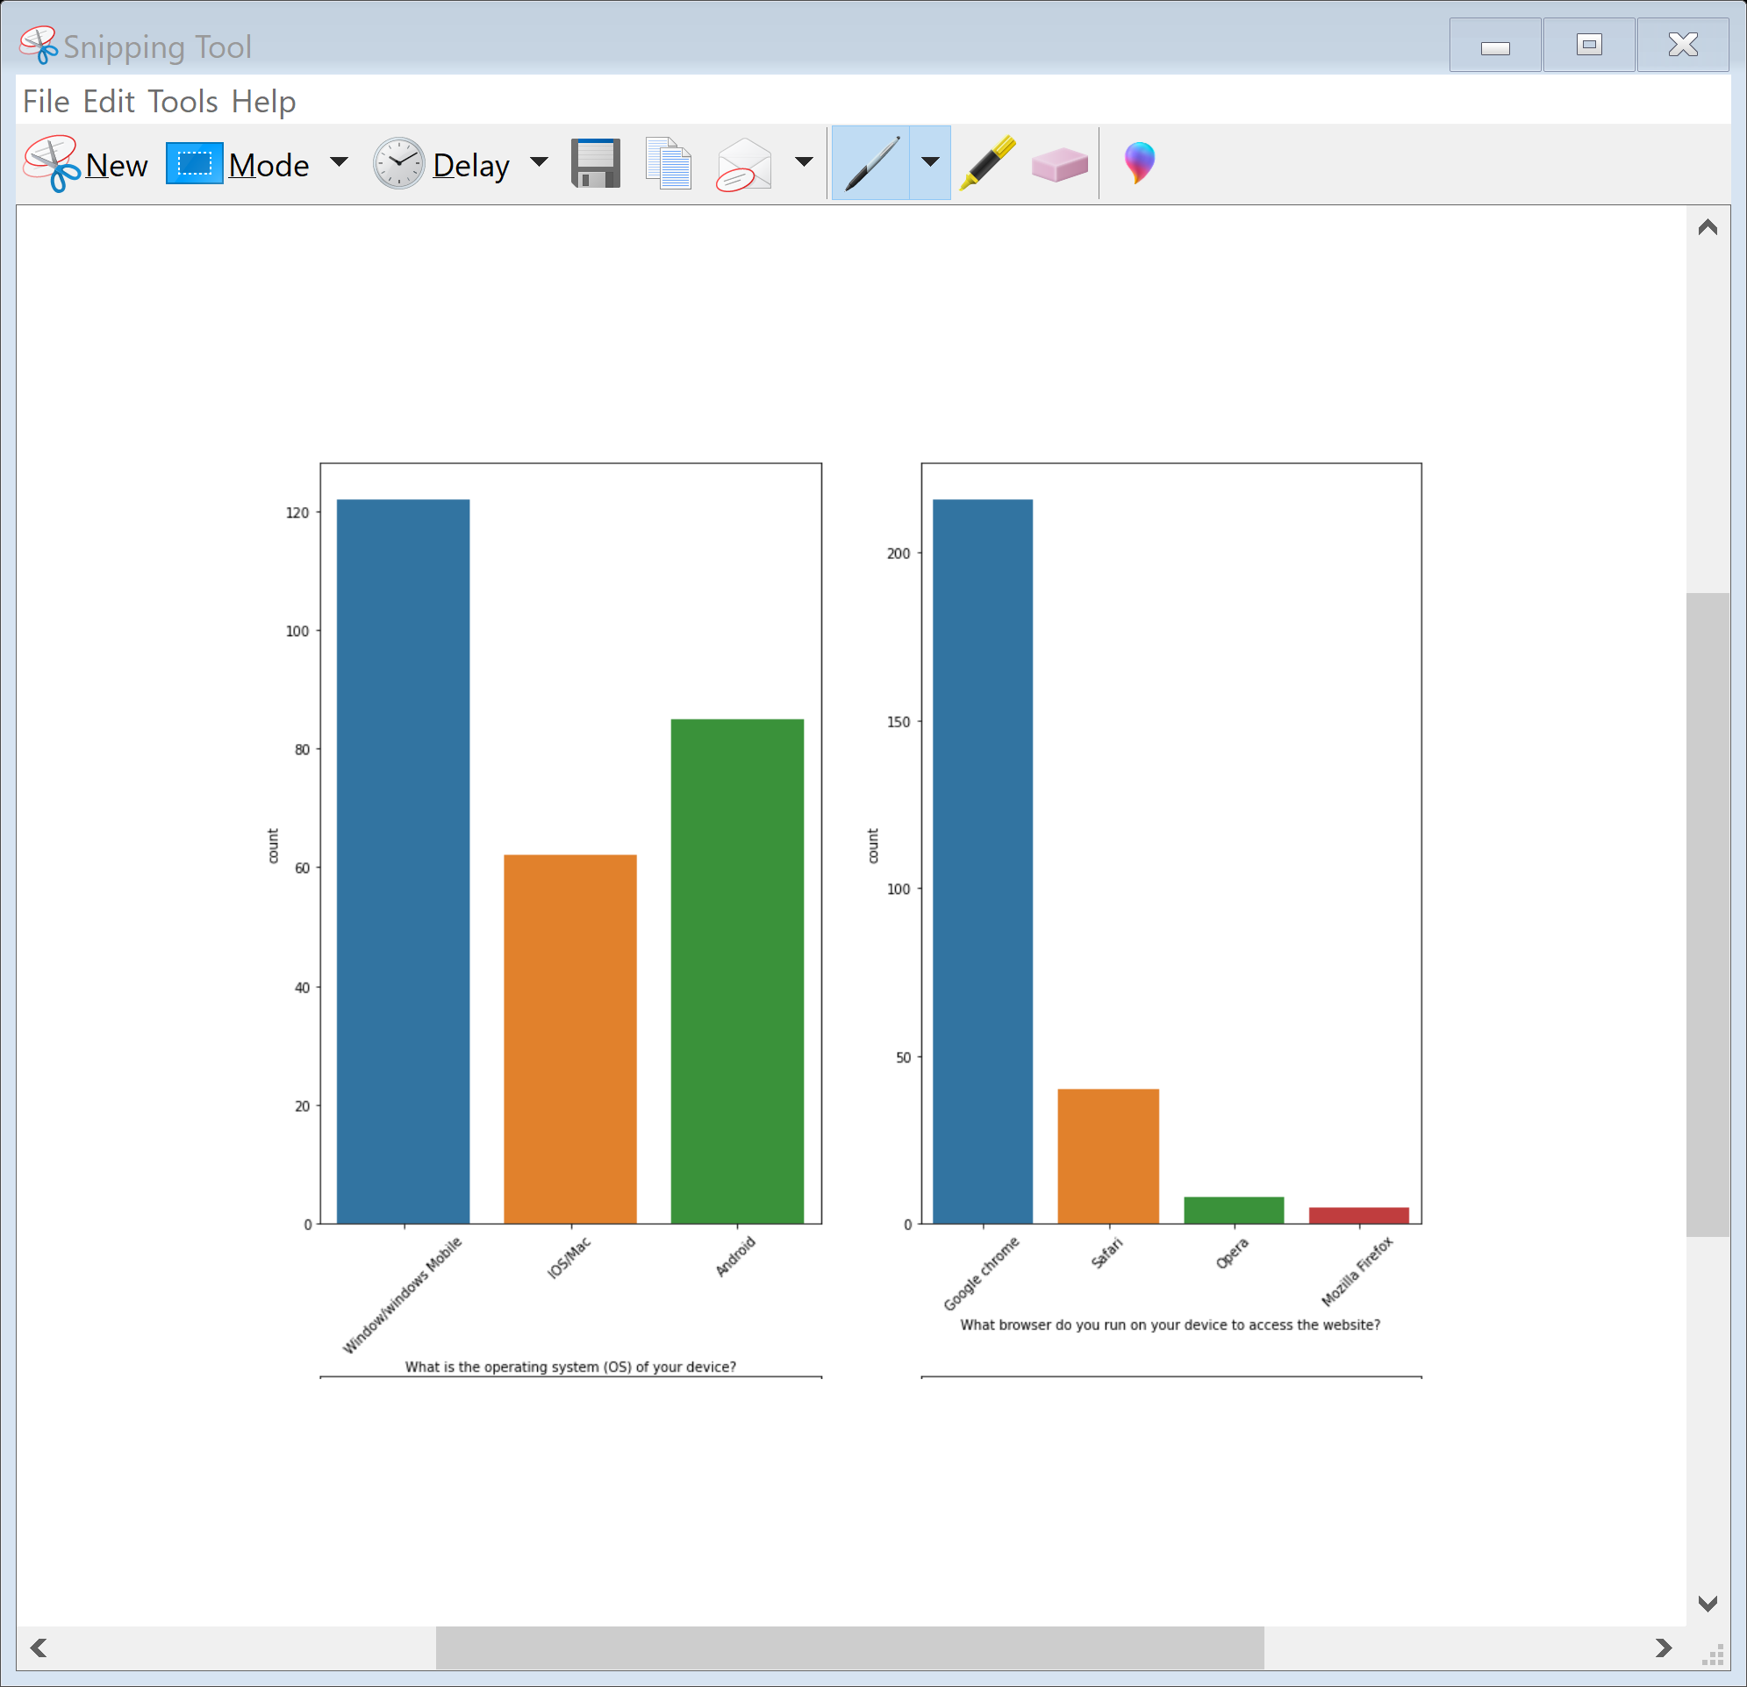
People residing in delhi are most intrested in online shopping as compared to other cities. As we can see people shopping for more than 4 years are more as compared to others. Most of the respondants use mobile internet and smartphone for online shopping. People having windows as operating system(OS) have maximum count. As google chrome has most user friendly interface so no of respondents are more who choose chrome for online shopping.

Slide 9
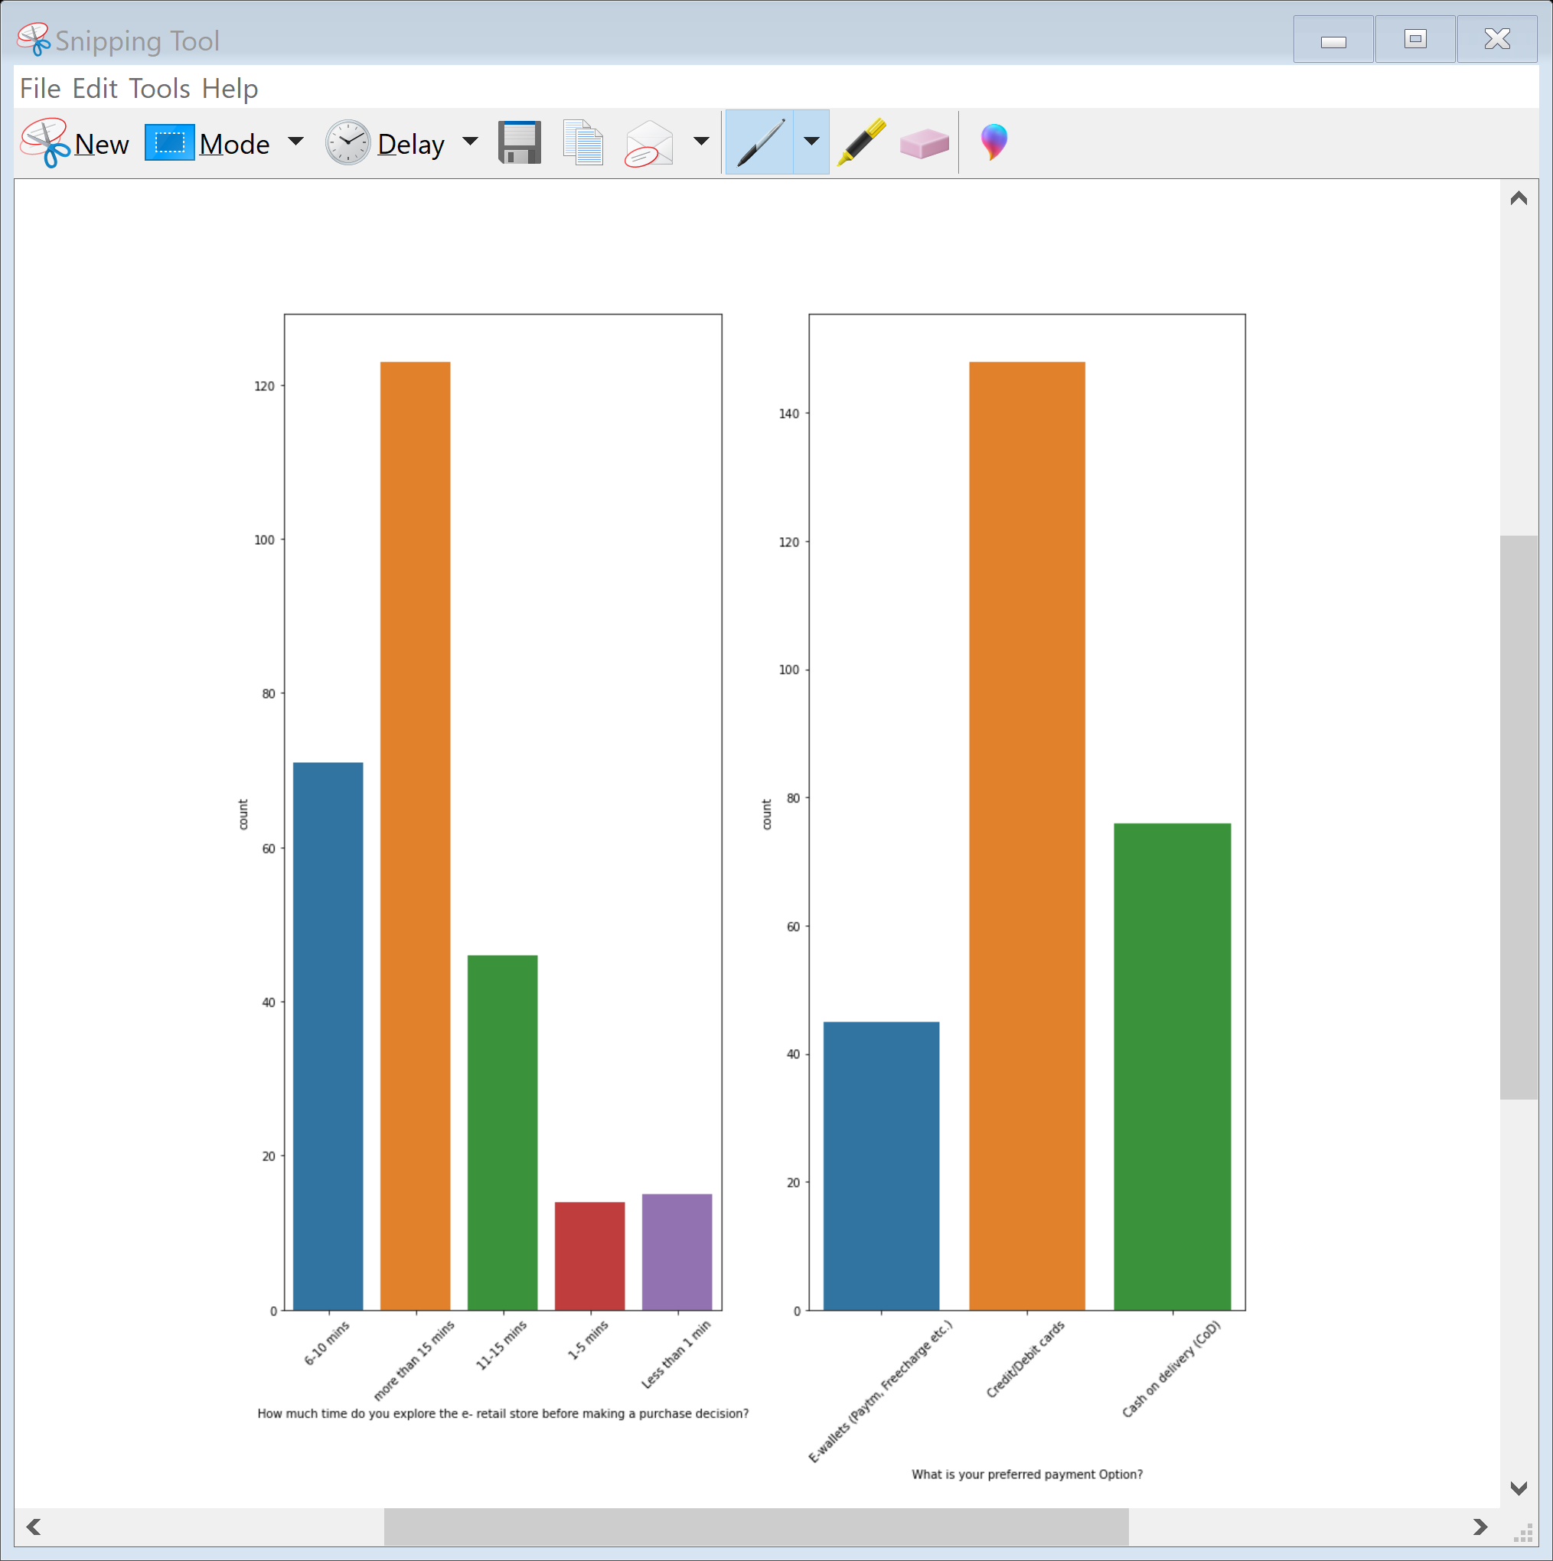
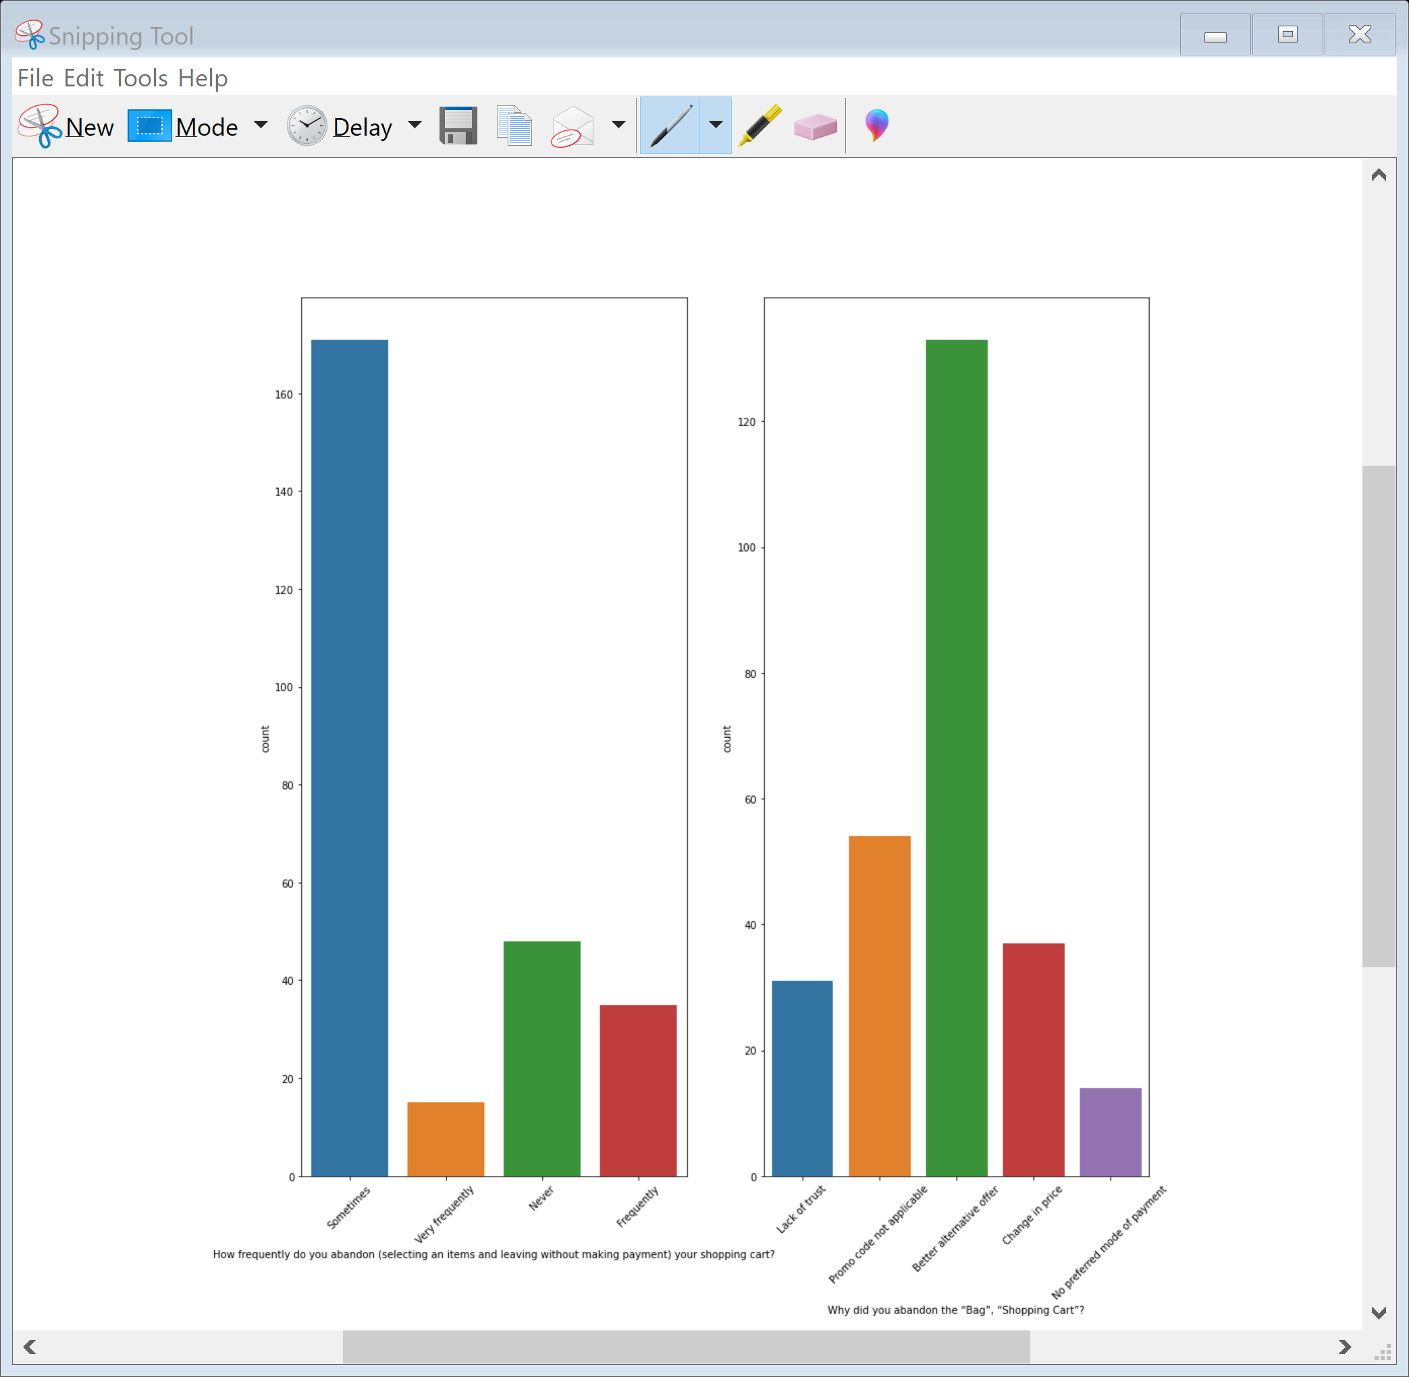
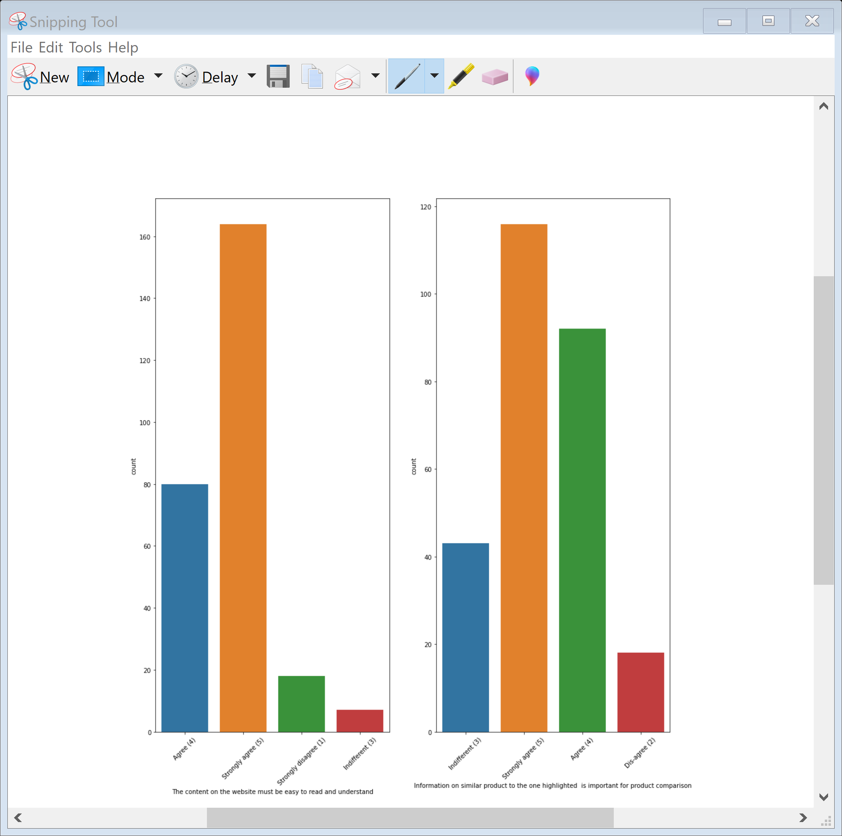
Most of the respondents explore for more than 15 mins and pay through credit or debit card as per their convenience. People abandon the Bag or Shopping Cart when they get better alternative offers

Slide 10
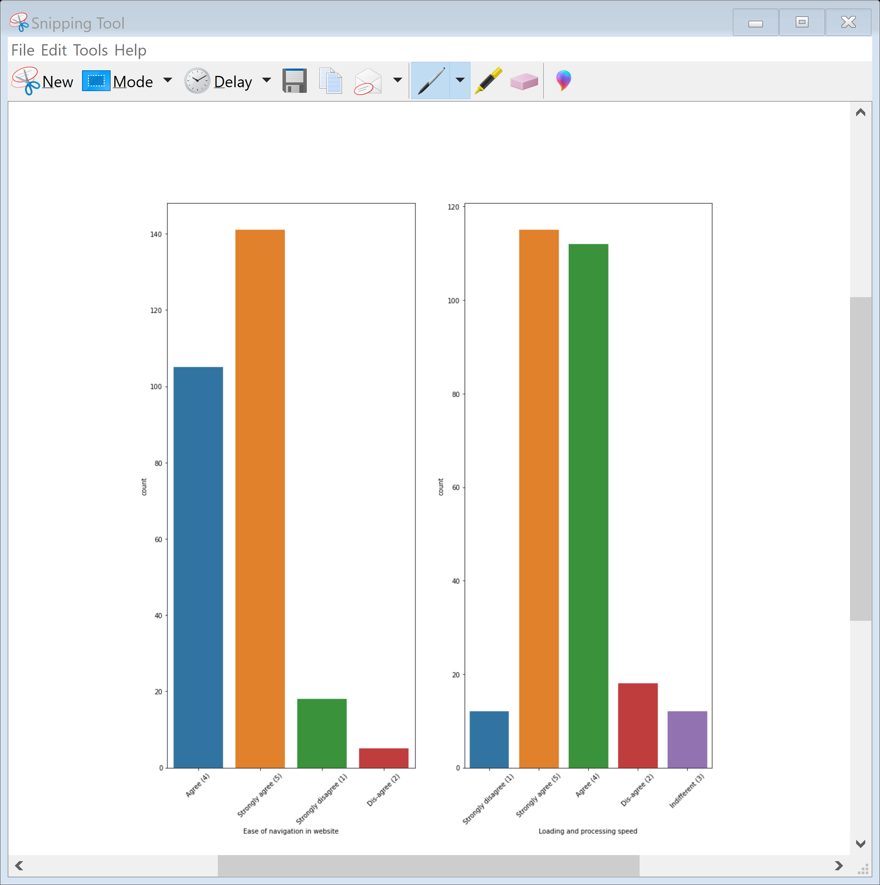
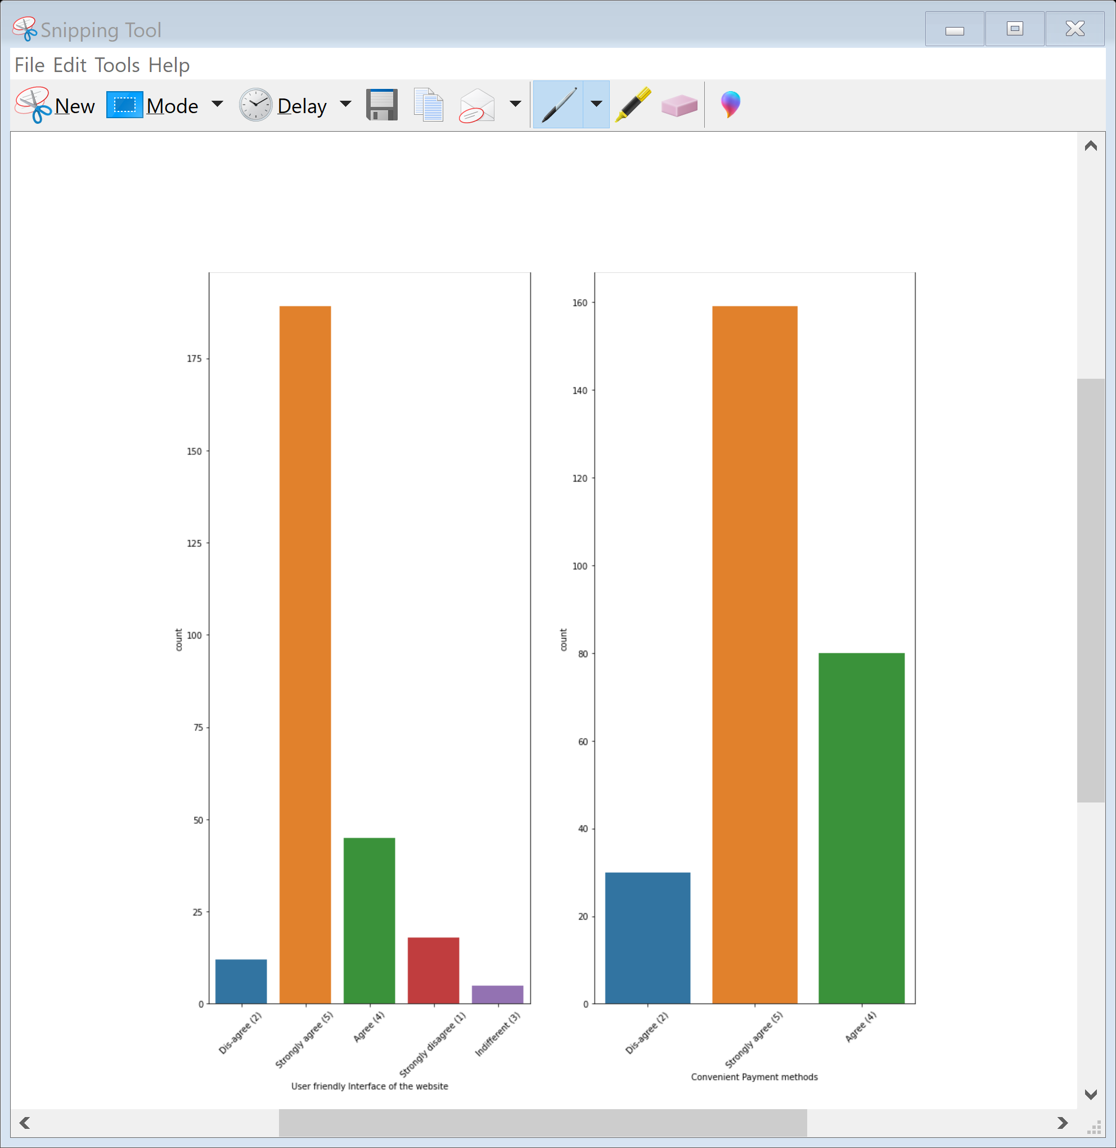
Most of the respondants strongly agree that content on the website should be easy to read and underdstand and their should be ease in navigation in website Most of the Respondents agree that Information on similar product to the one highlighted is important for product comparison and complete information on listed seller and product being offered is important for purchase decision. Most of the respondents agree that All relevant information on listed products must be stated clearly. Loading and Processing time should be low and Website should has user friendly interface and also payment method should be convenient

Slide 11

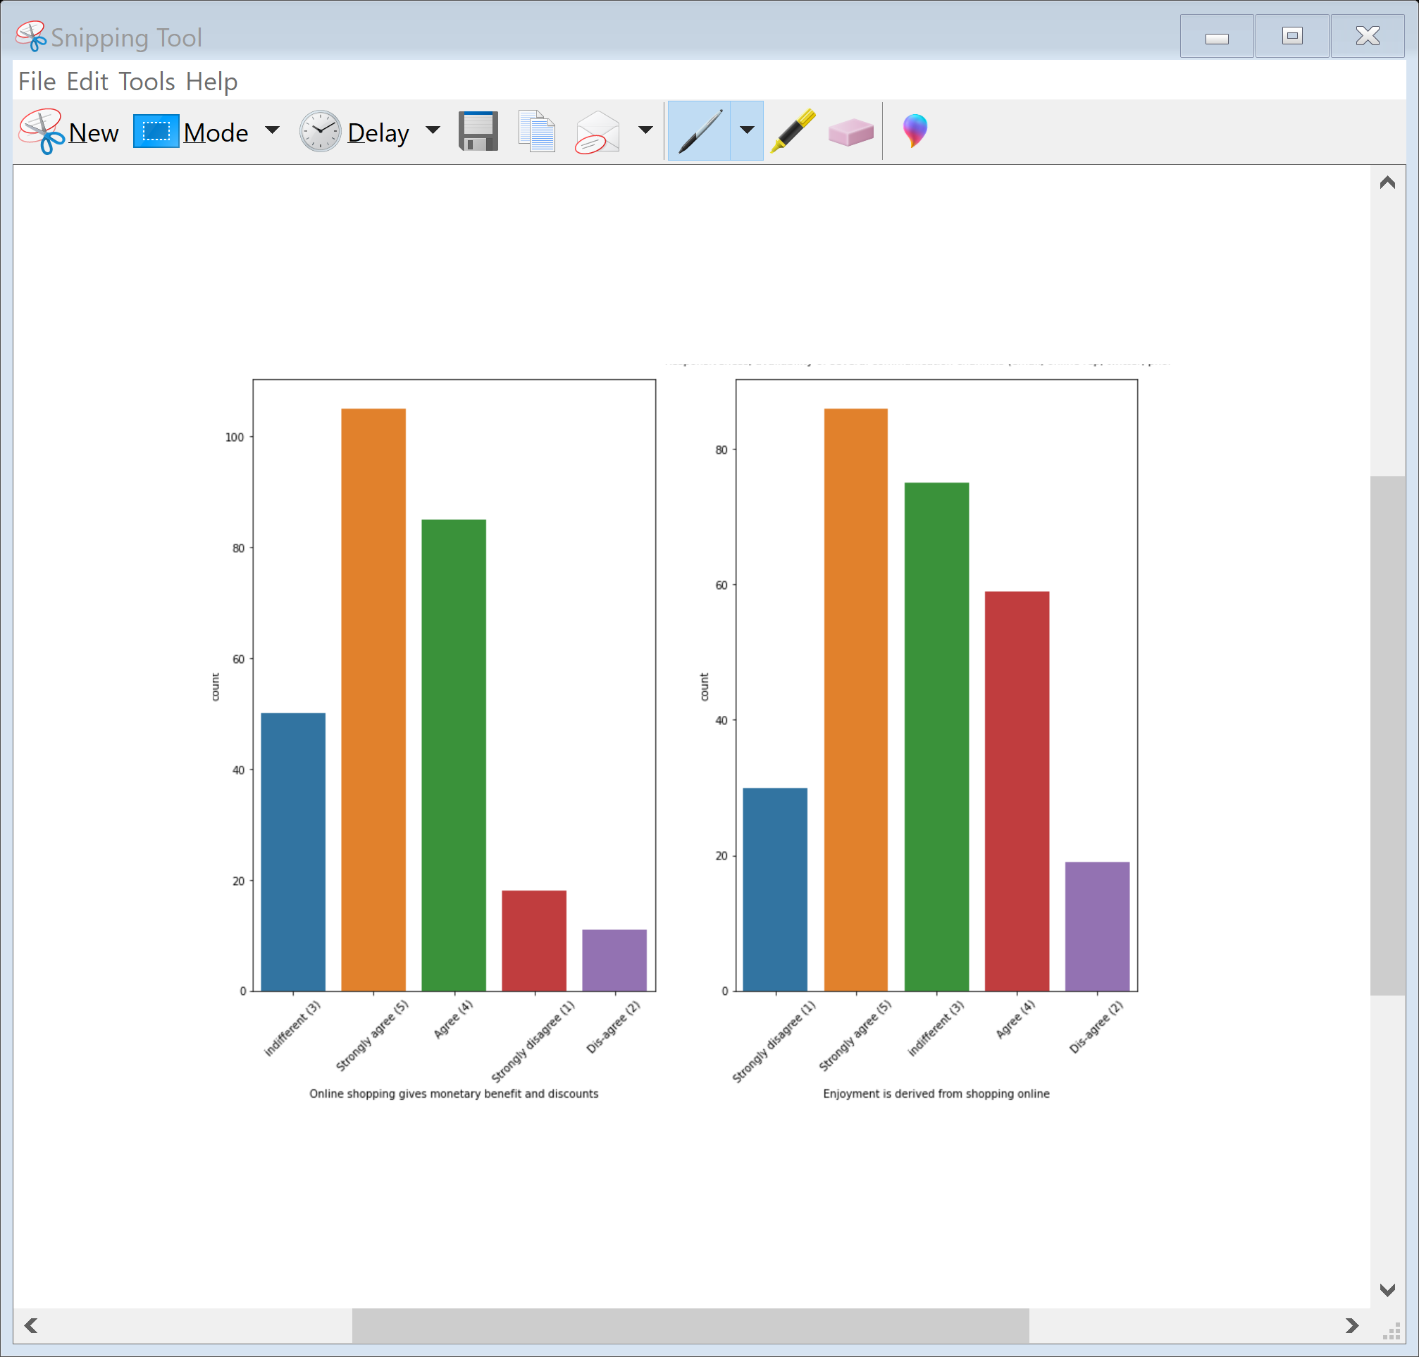
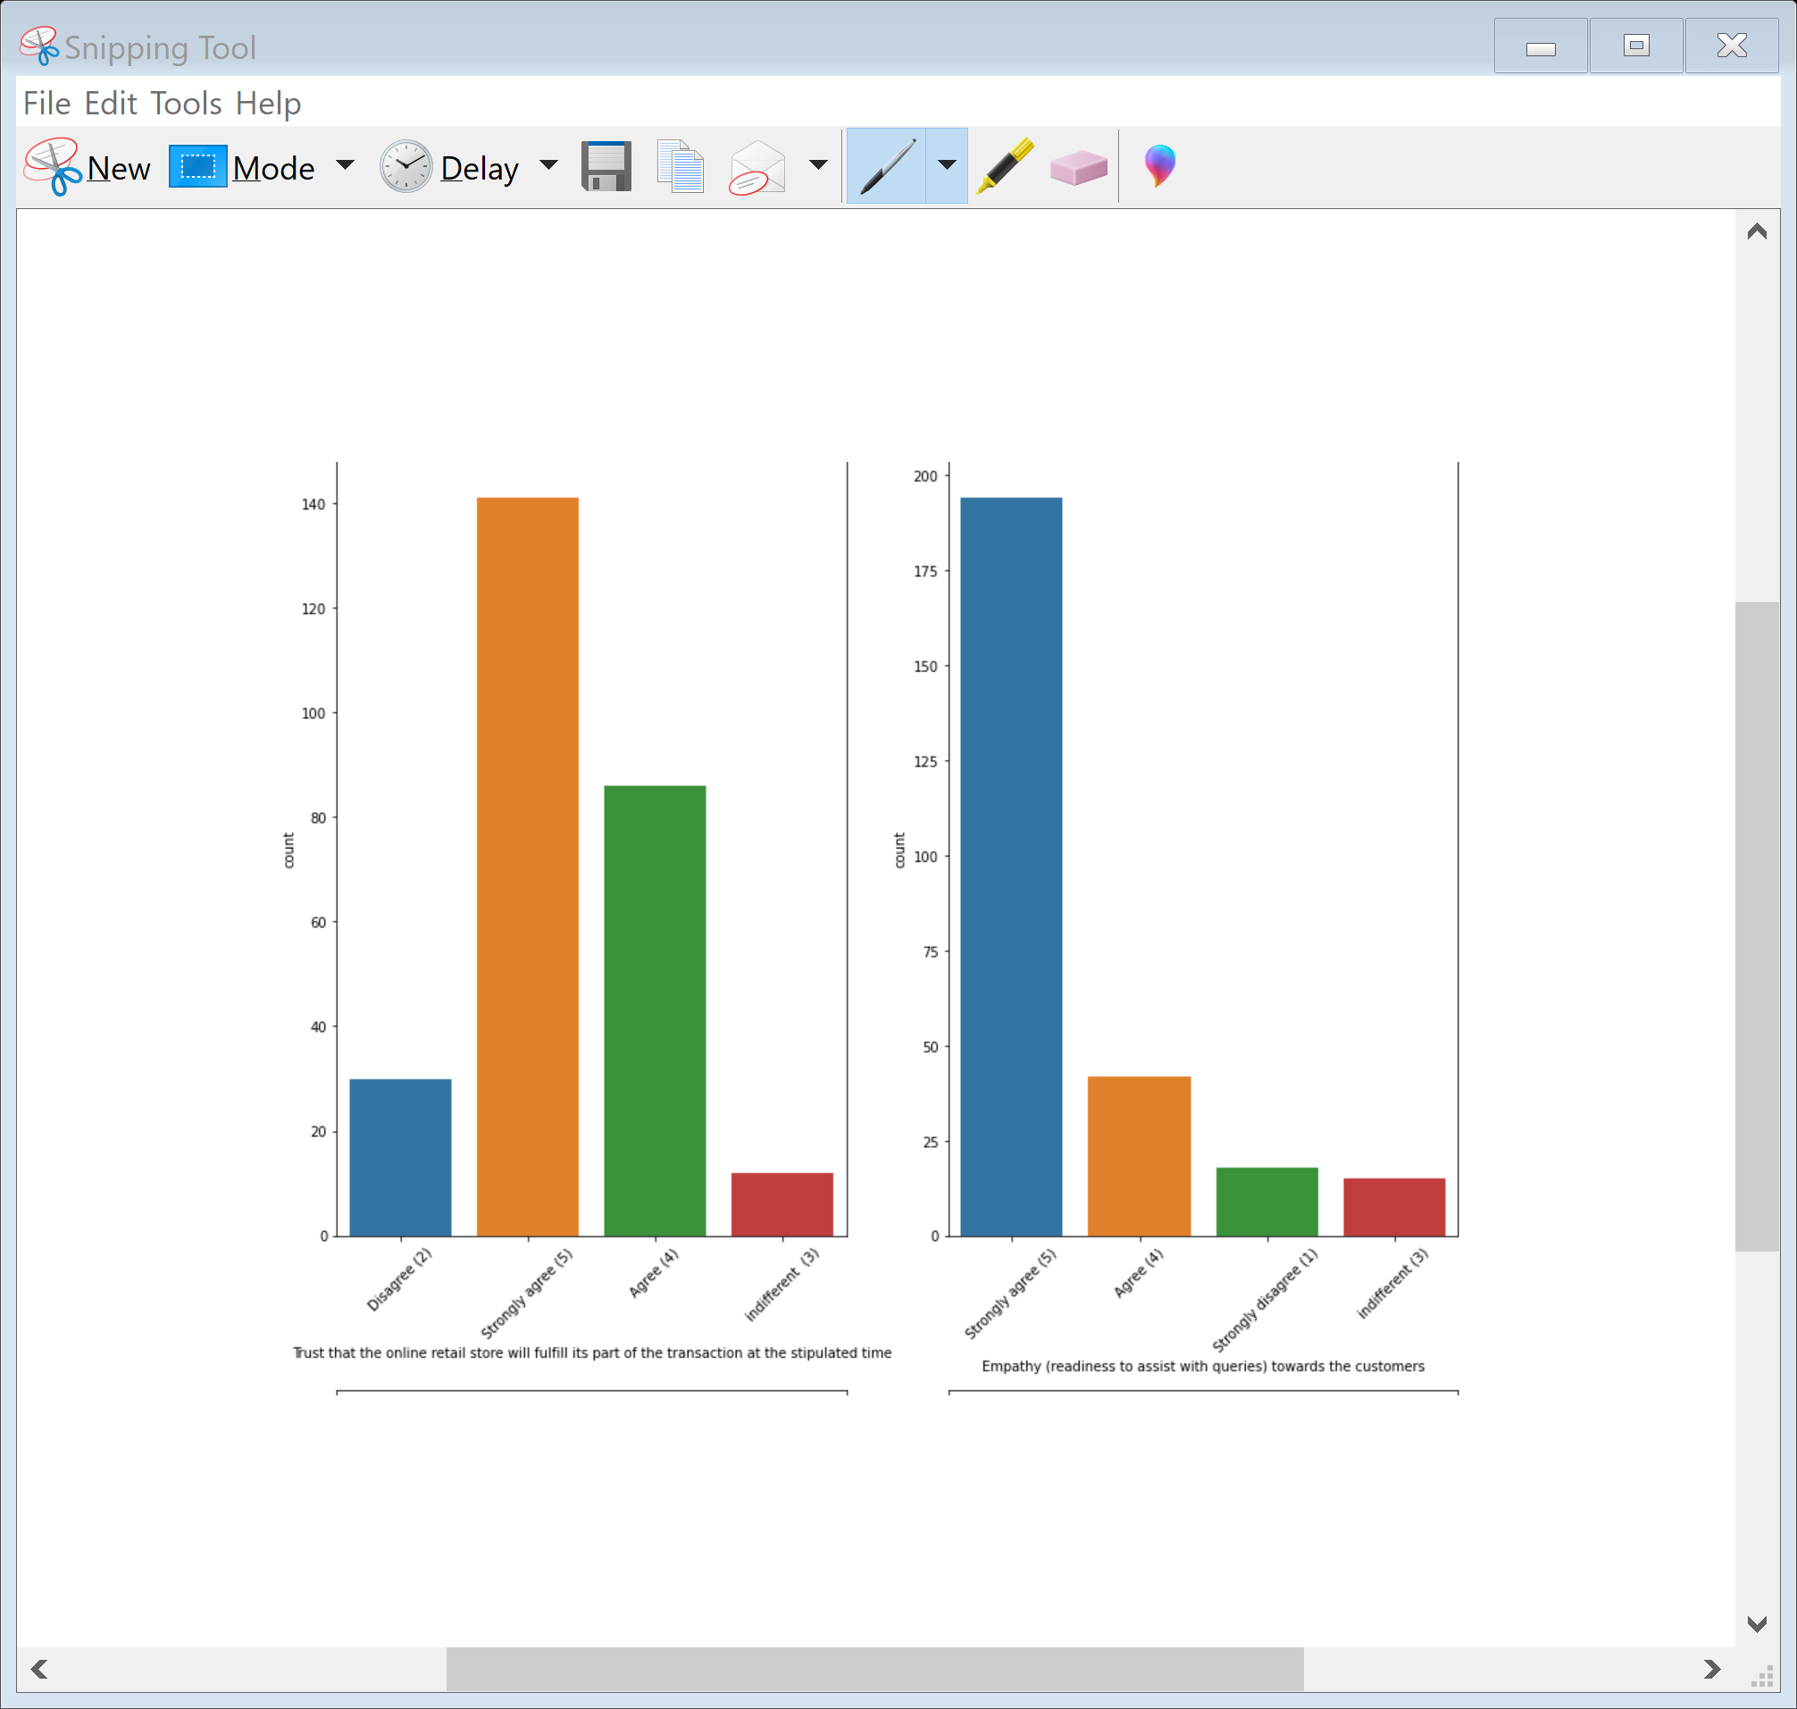
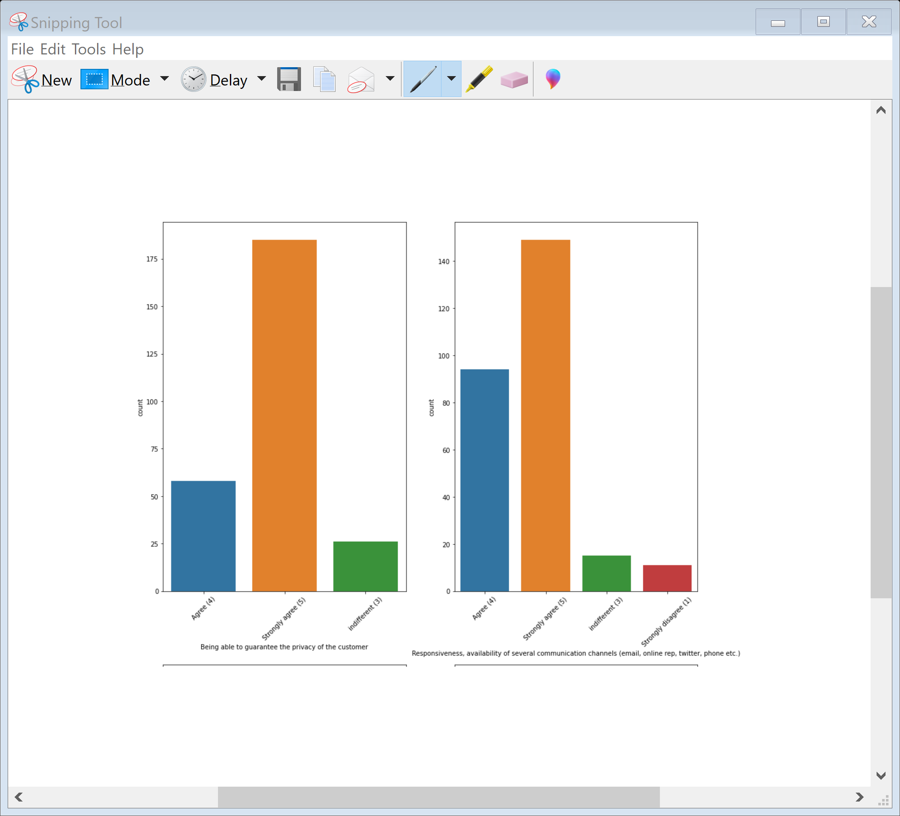
Website should be readiness to assist with queries towards the customers and Website should able to guarantee the privacy of the customer. Responsiveness, availability of several communication channels (email, online rep, twitter, phone etc ) is necessary. Online shopping gives monetary benefit and discounts to the customers

Slide 12
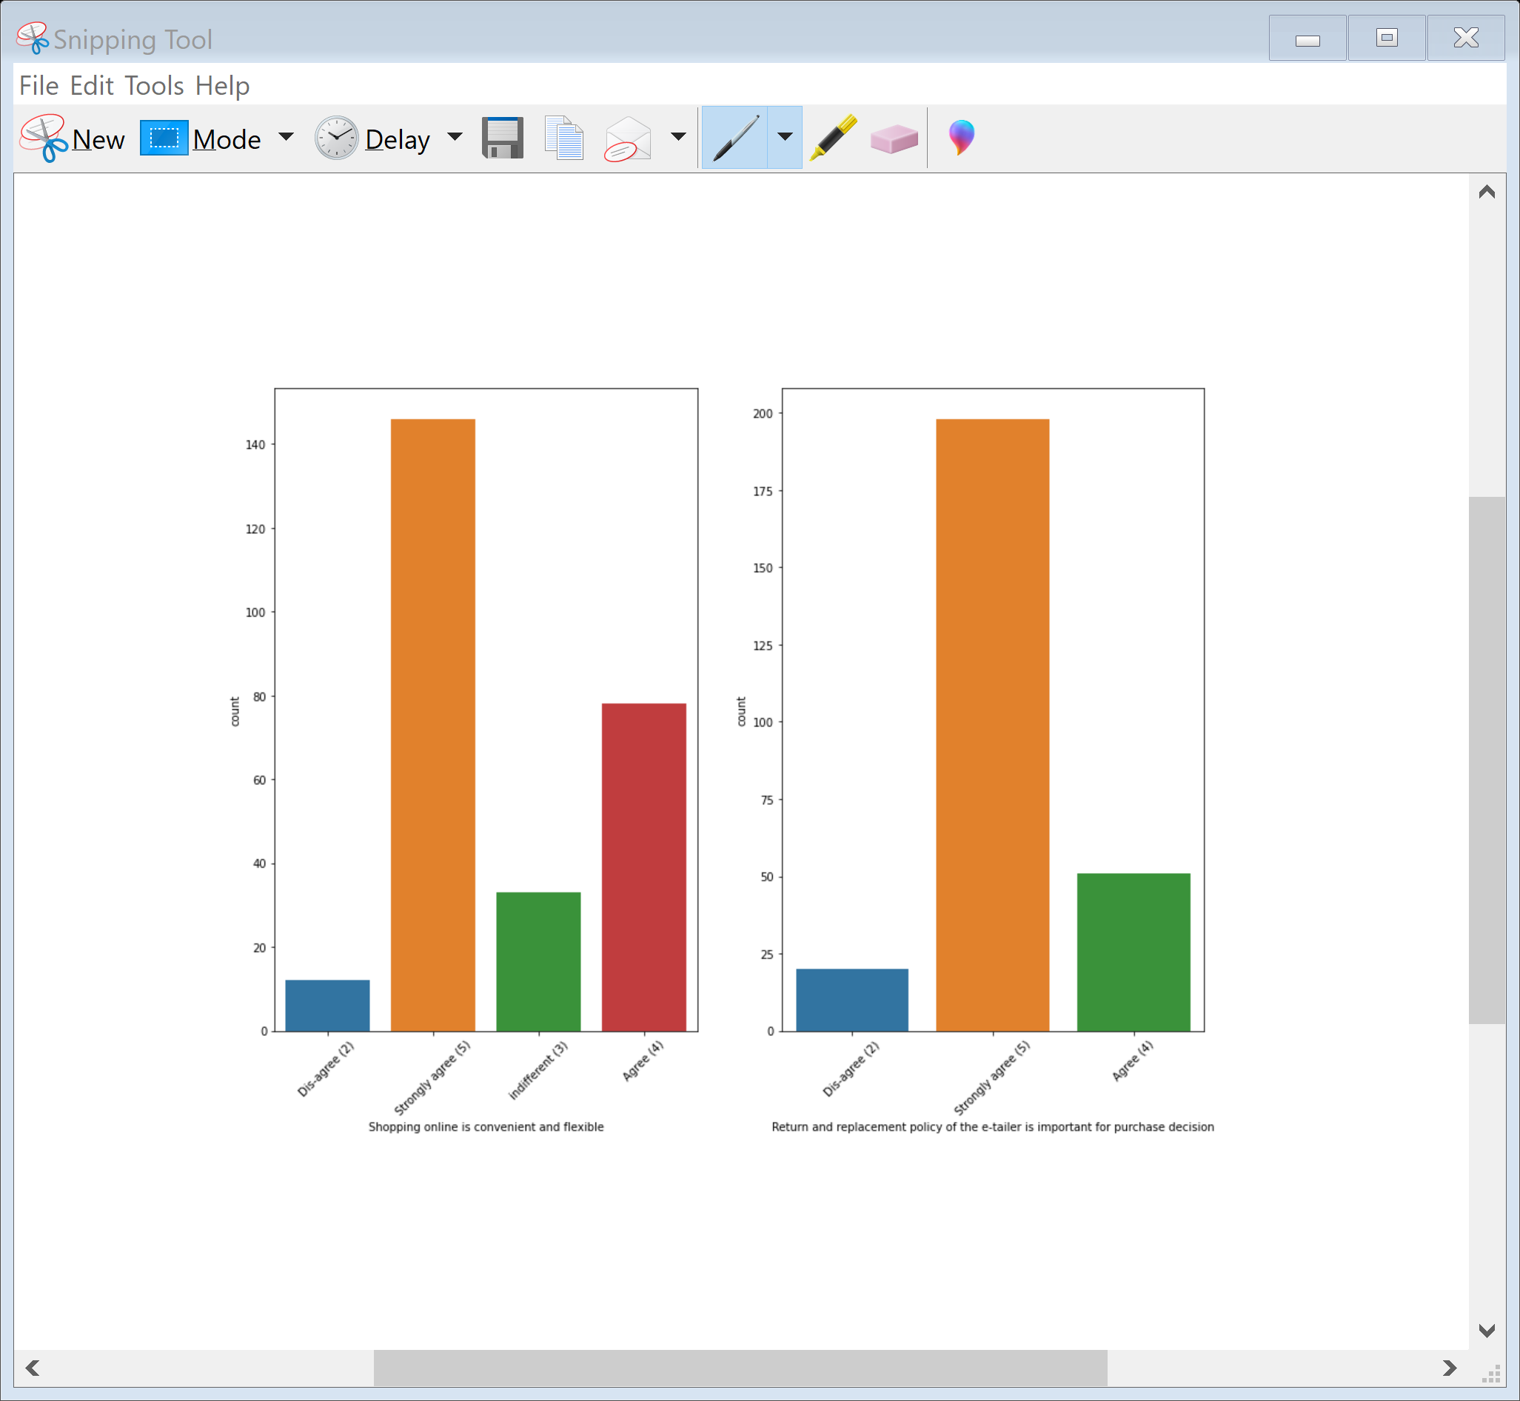
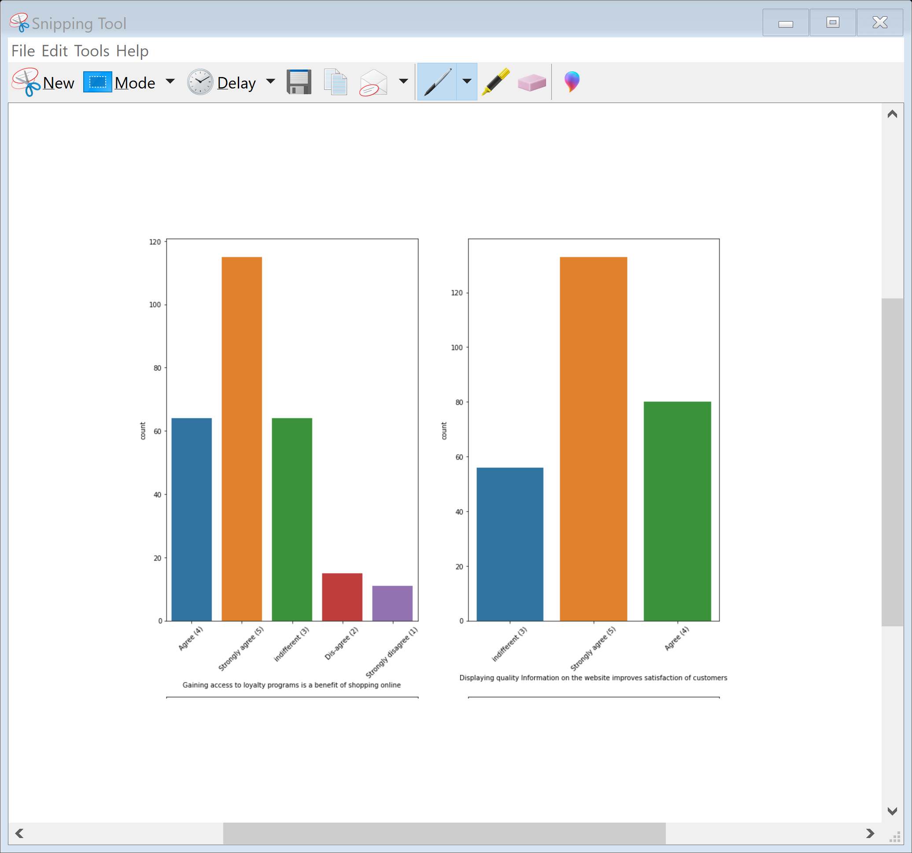
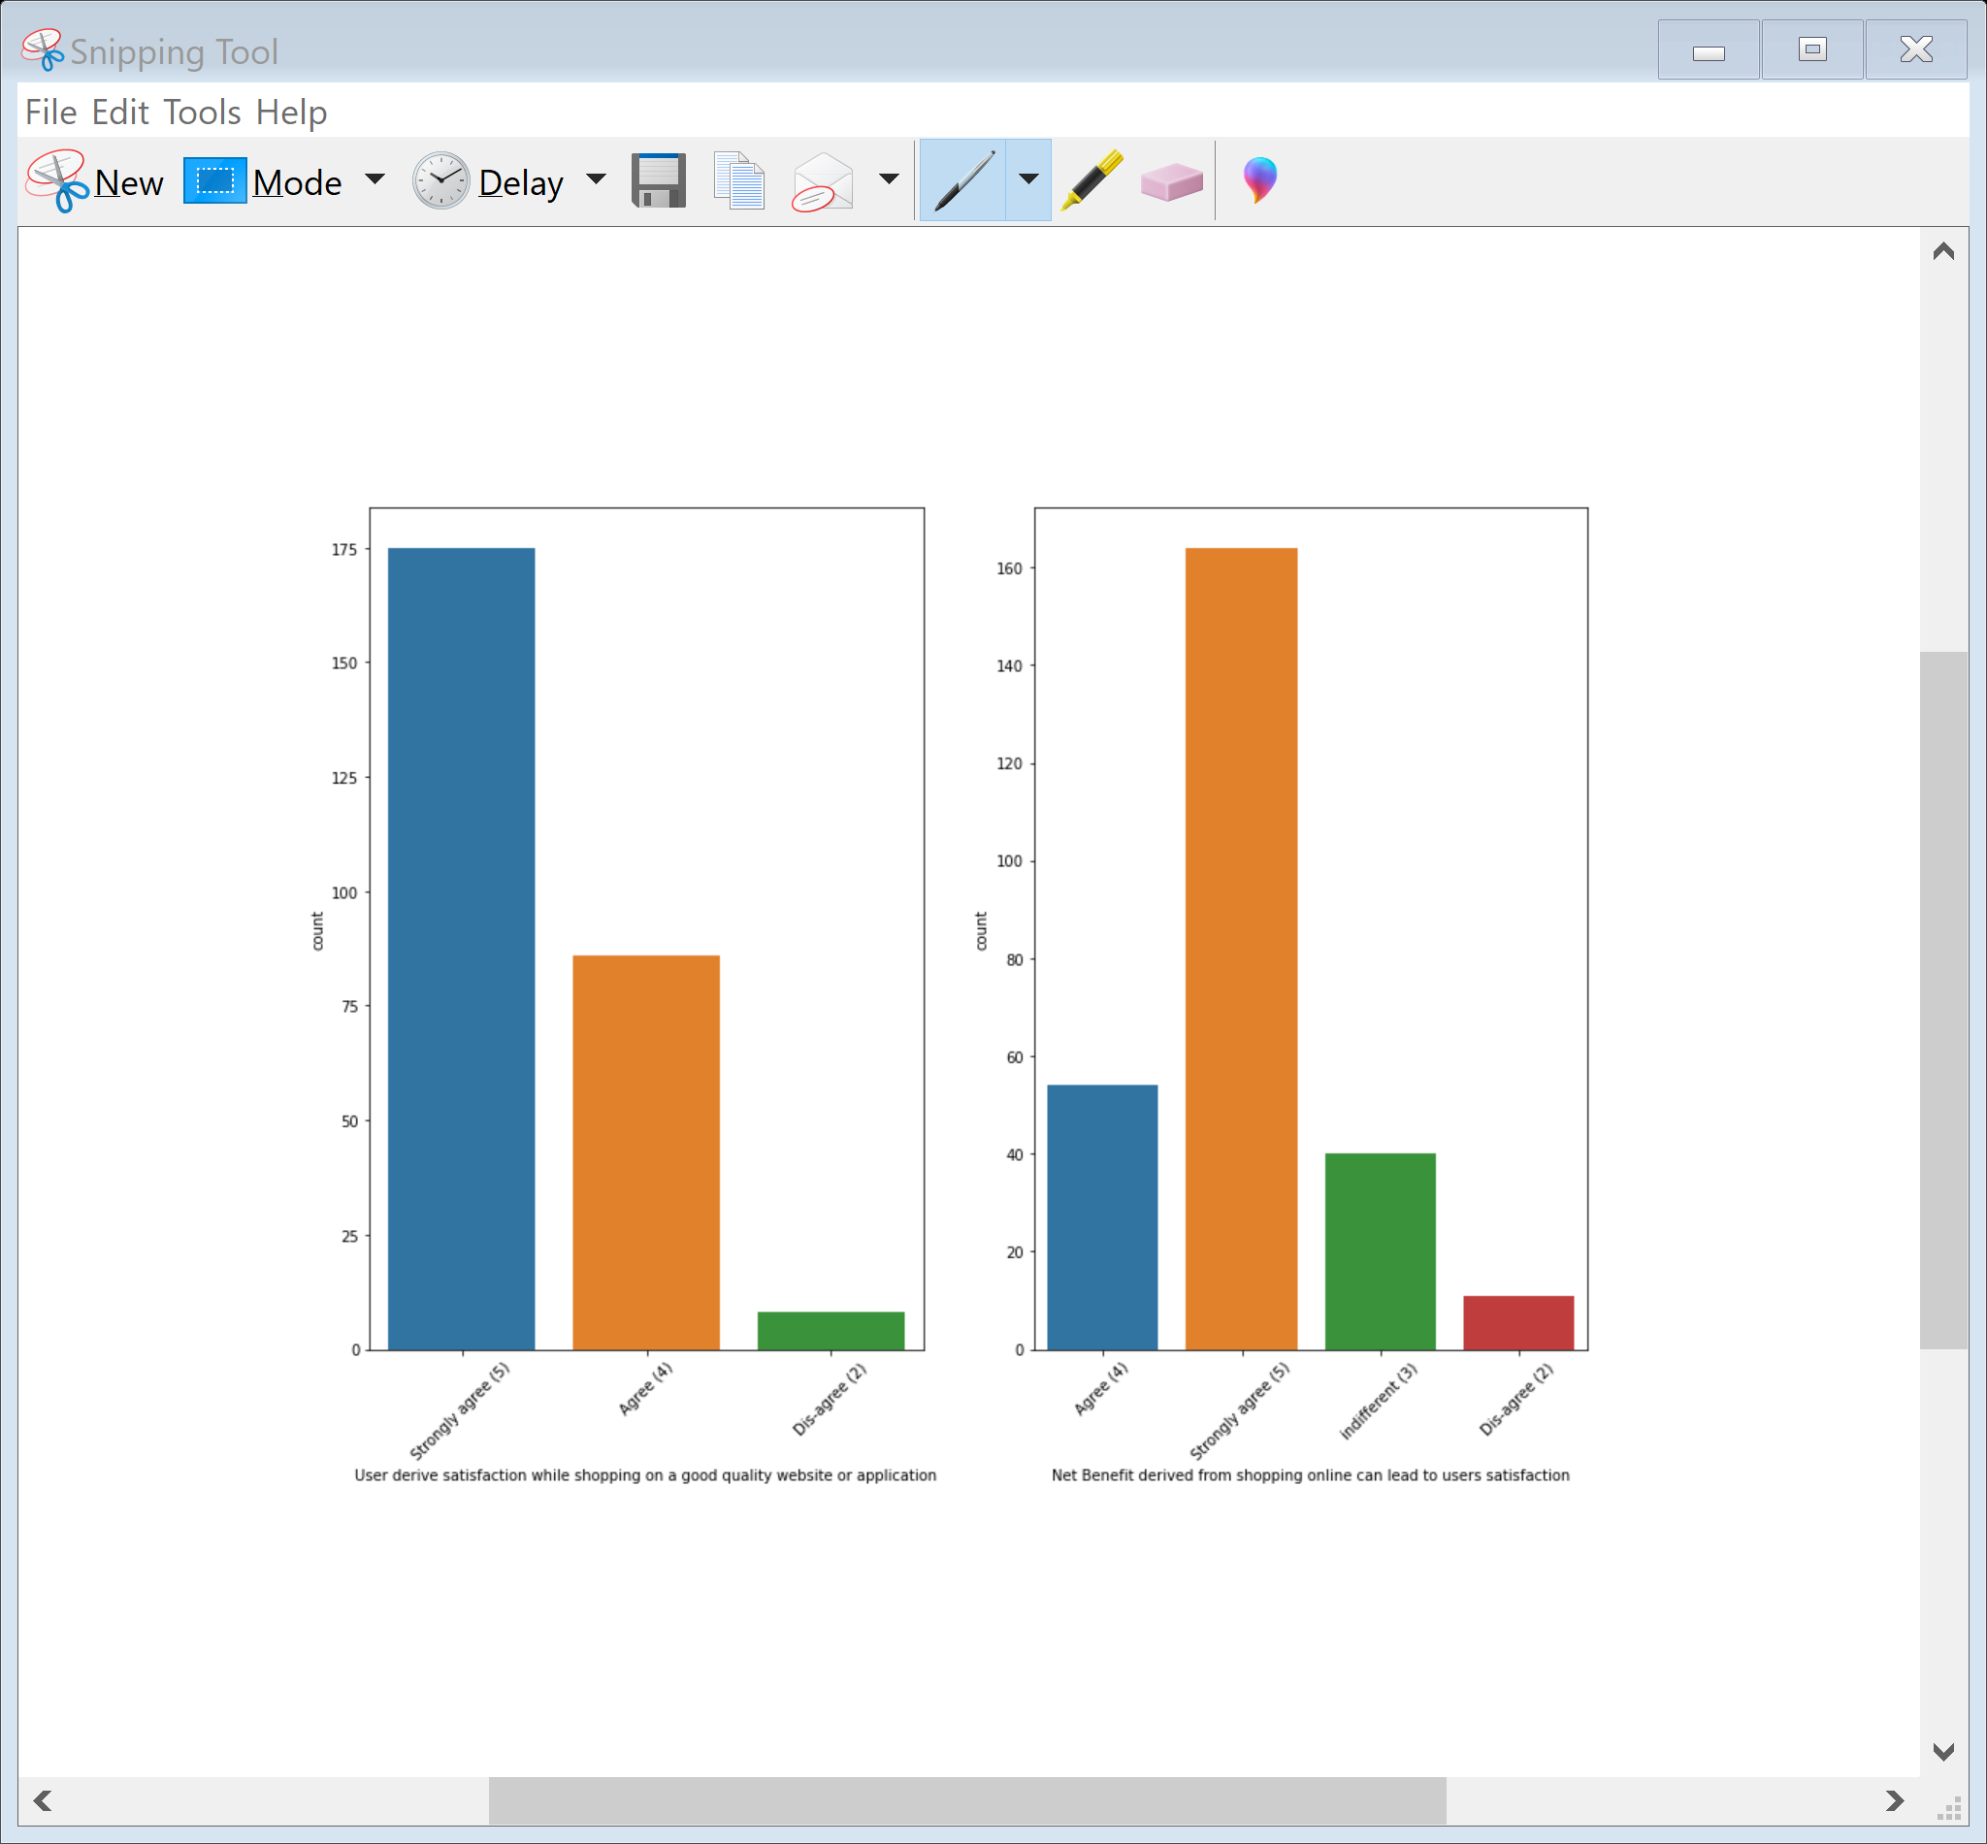
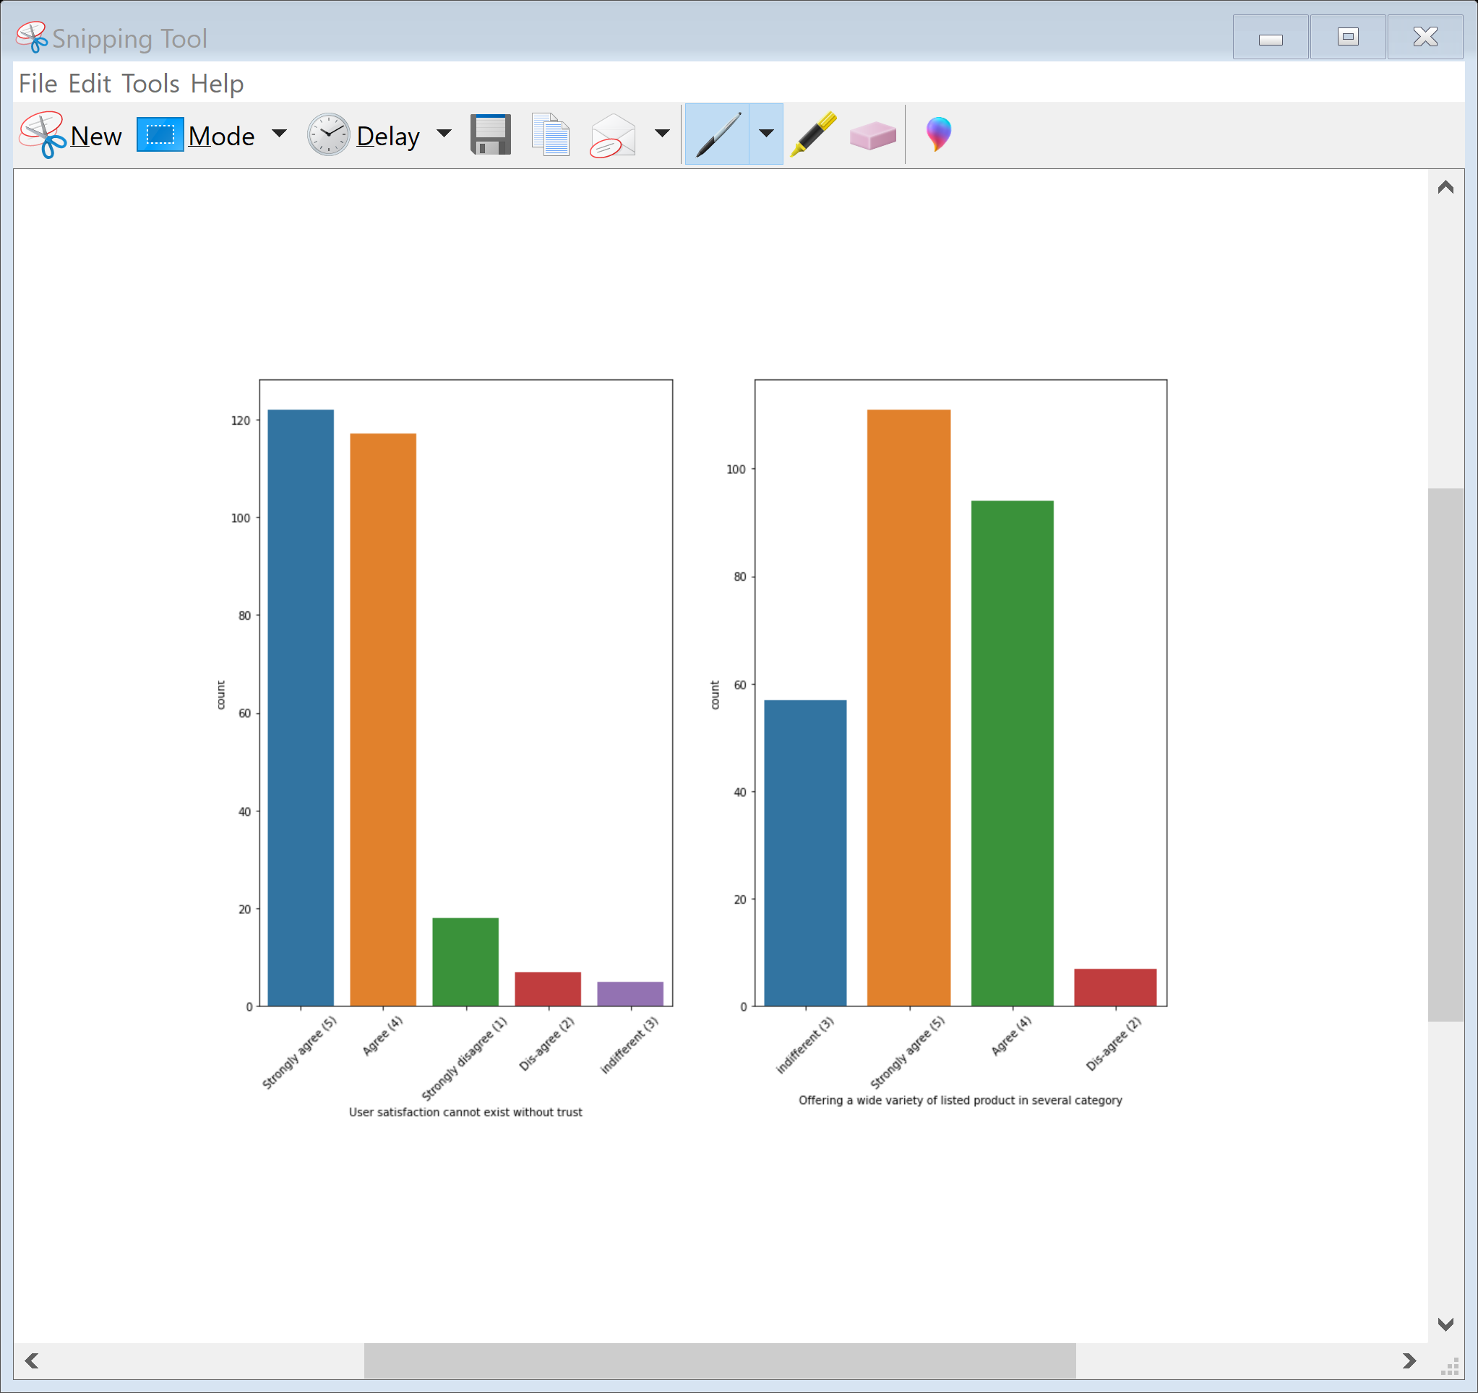
Shopping online is convenient and flexible , Return and replacement policy of the e-tailer is important for purchase decision. Gaining access to loyalty programs is a benefit of shopping online. Displaying quality Information on the website improves satisfaction of customers. User derive satisfaction while shopping on a good quality website or application and Net benifit derived from shopping online can lead to user satisfaction. User satisfaction exist when they have a trusted website. Website Offering a wide variety of listed product in several category makes the website user friendly

Slide 13
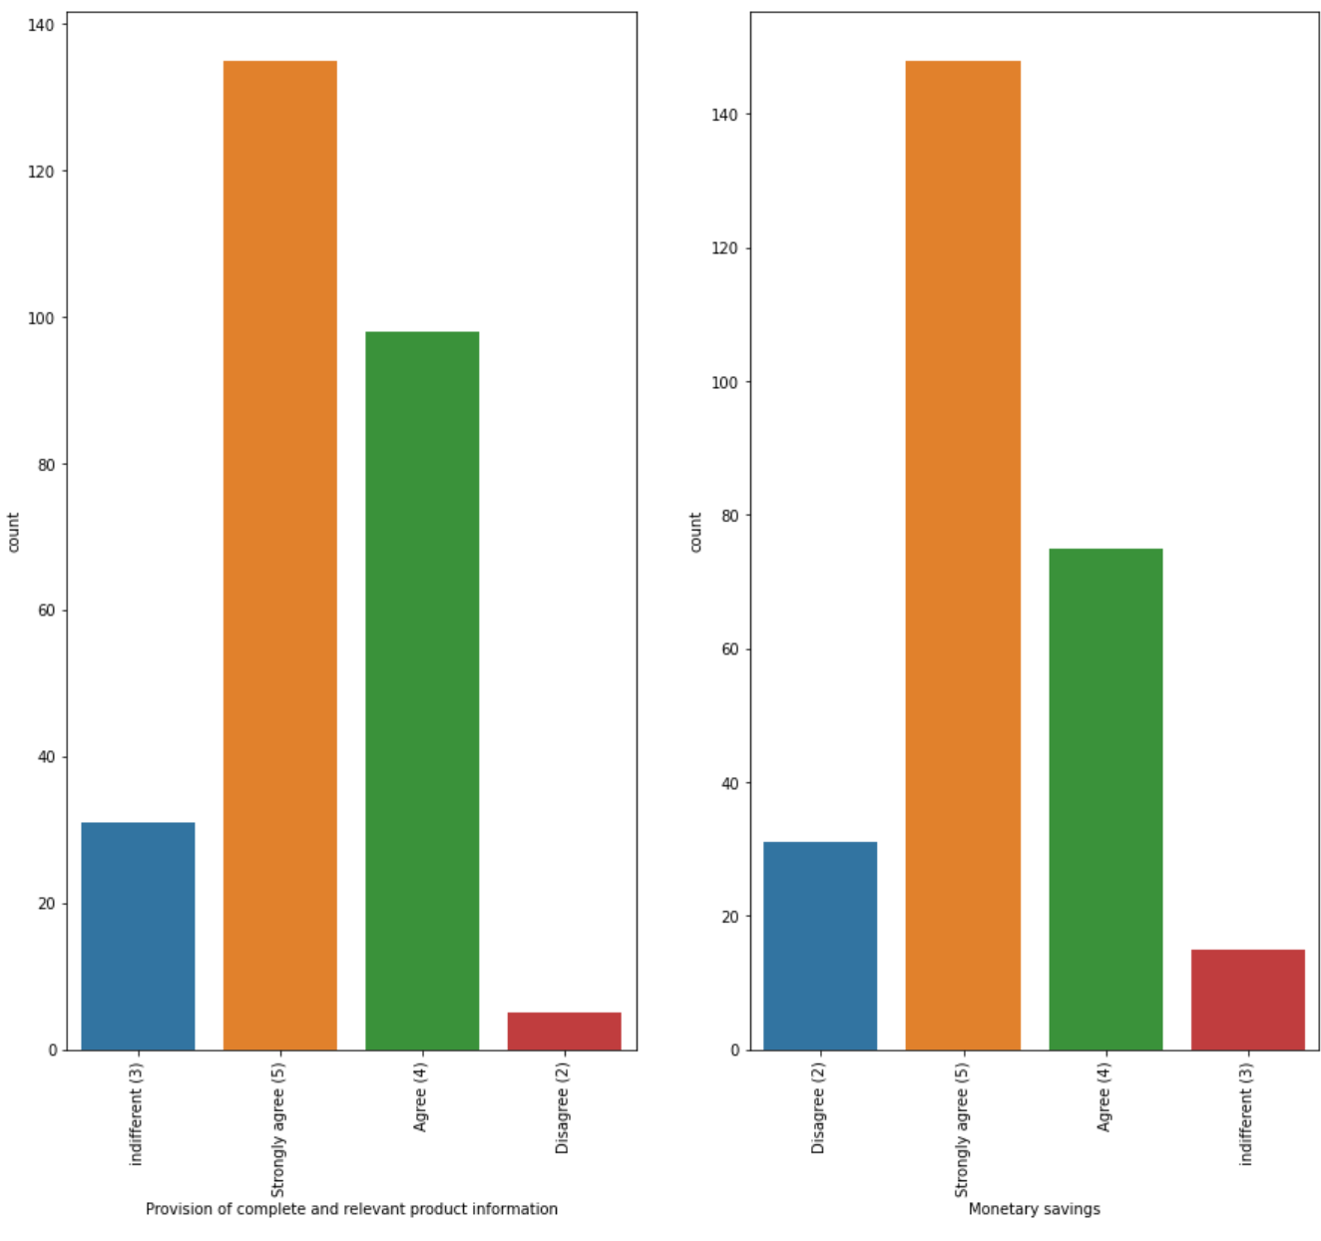
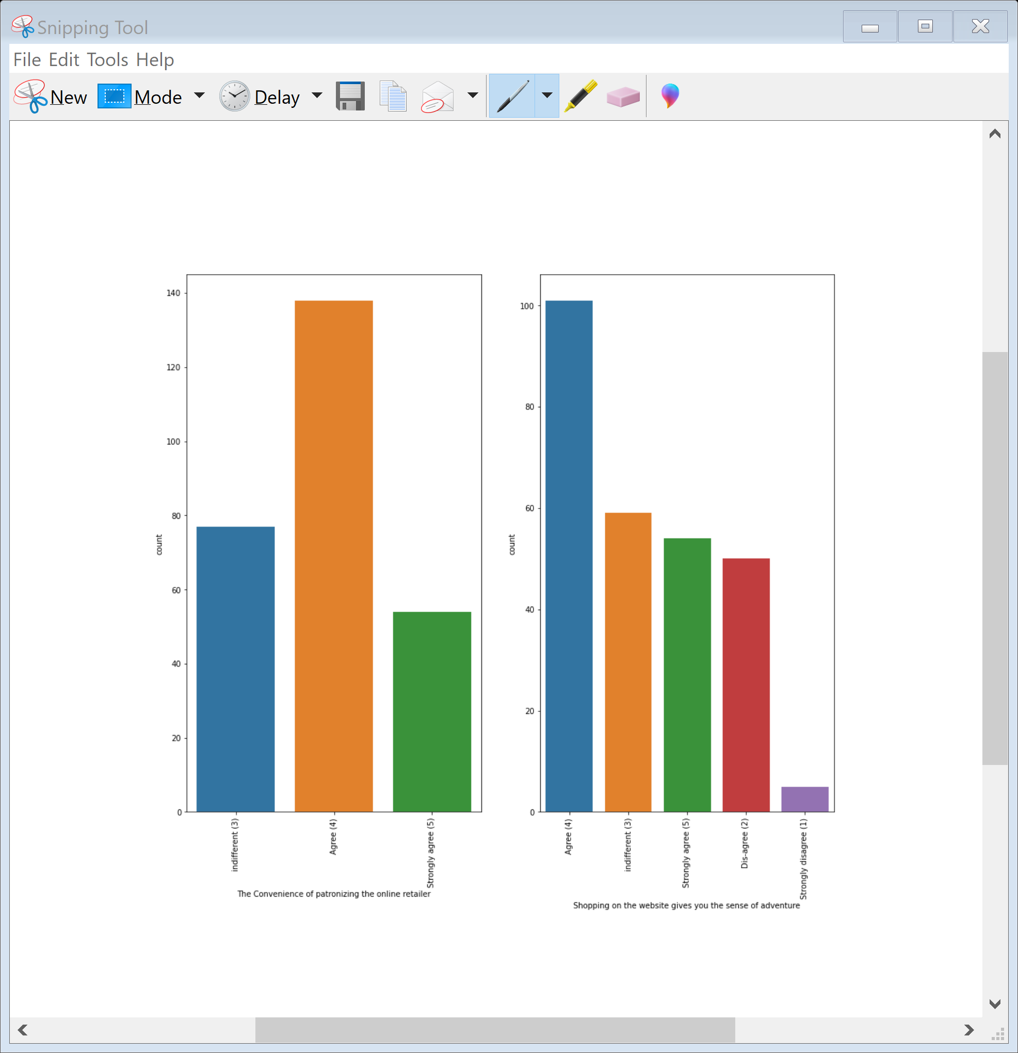
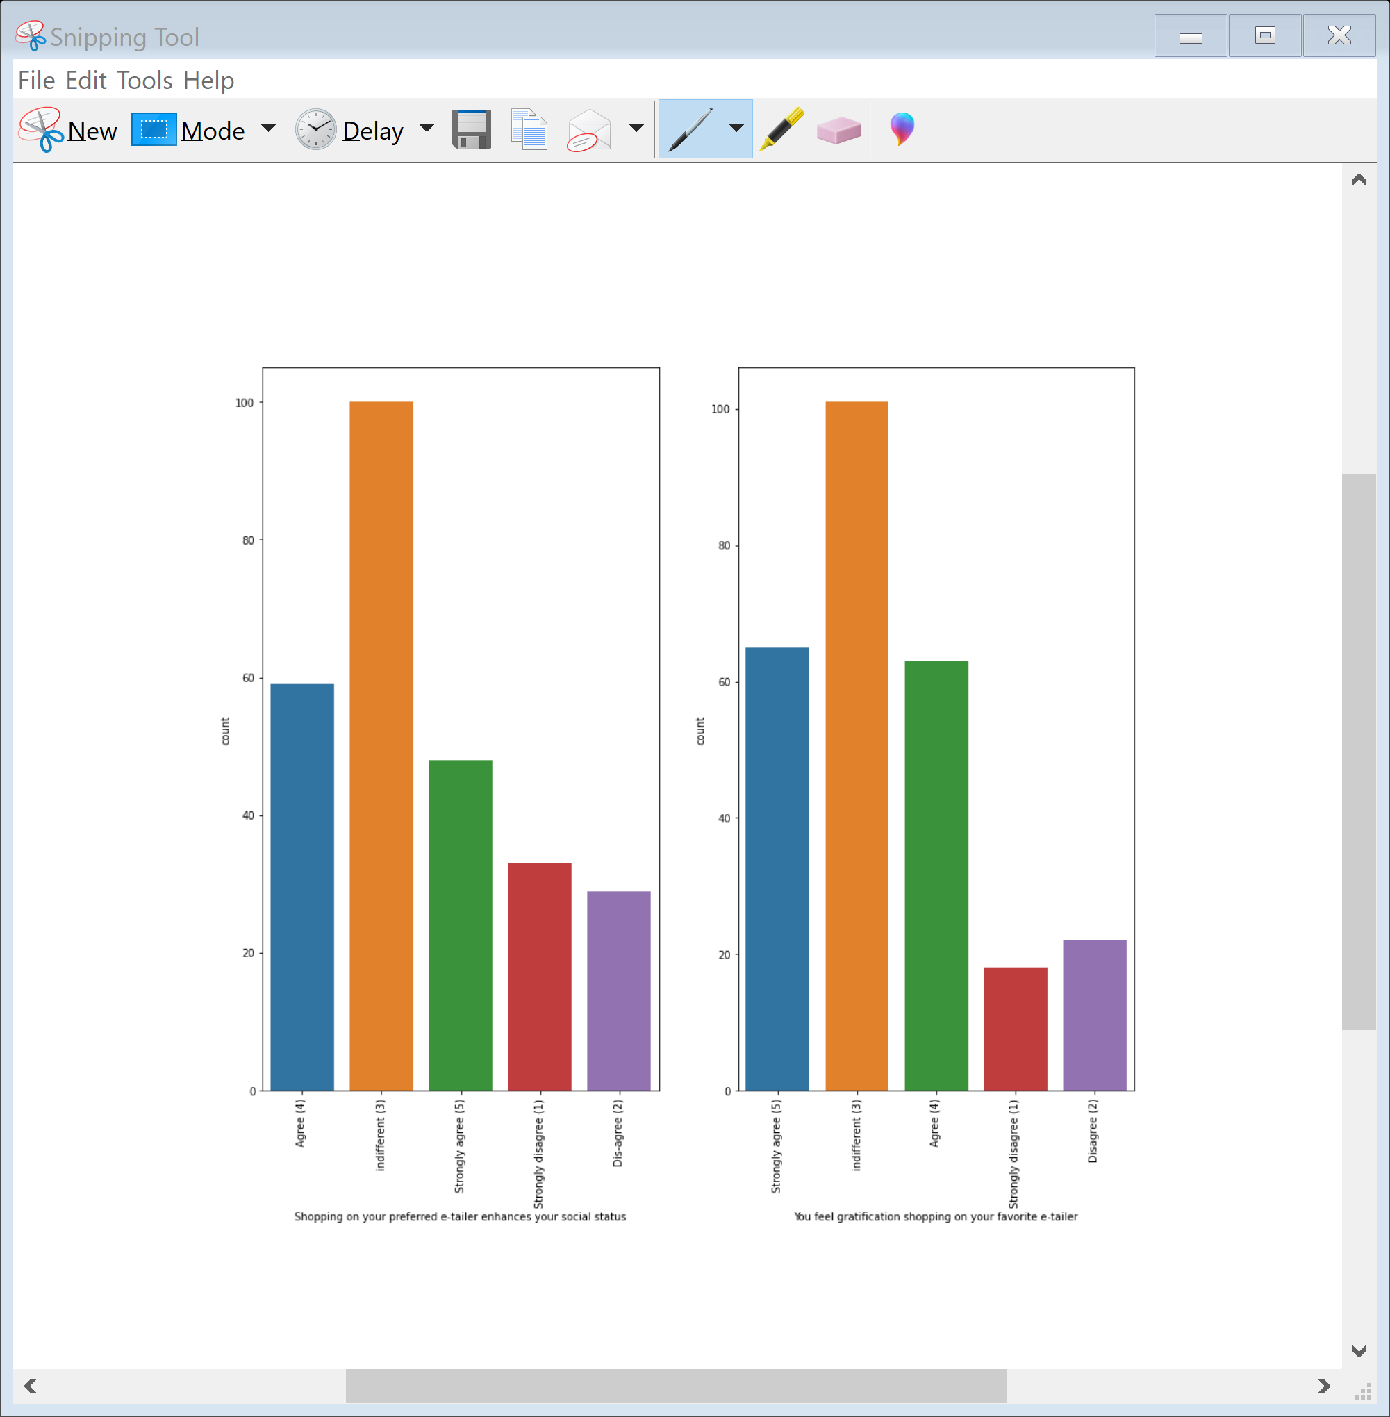
Most of the Users strongly agree that their should be provision of complete and relevant product information website and online shopping give monetary savings. Most of the Users agree that shopping on the website give them sense of adventure. Users have indifferent opnion that shopping on their preferred e-tailer enhances their social status. Users have mixed reaction on wheither shopping on website helps them to fulfil certain roles some agree it some are indifferent.

Slide 14
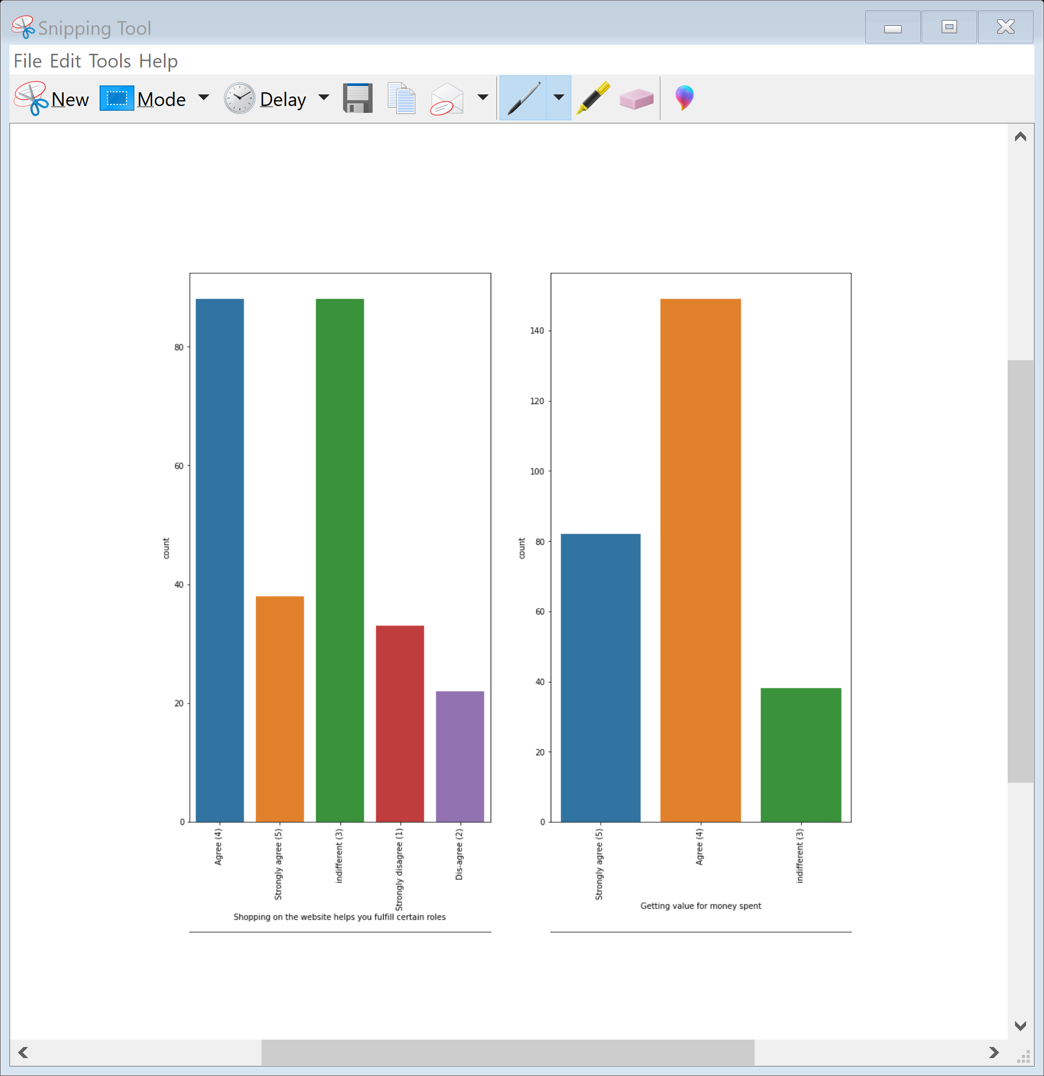
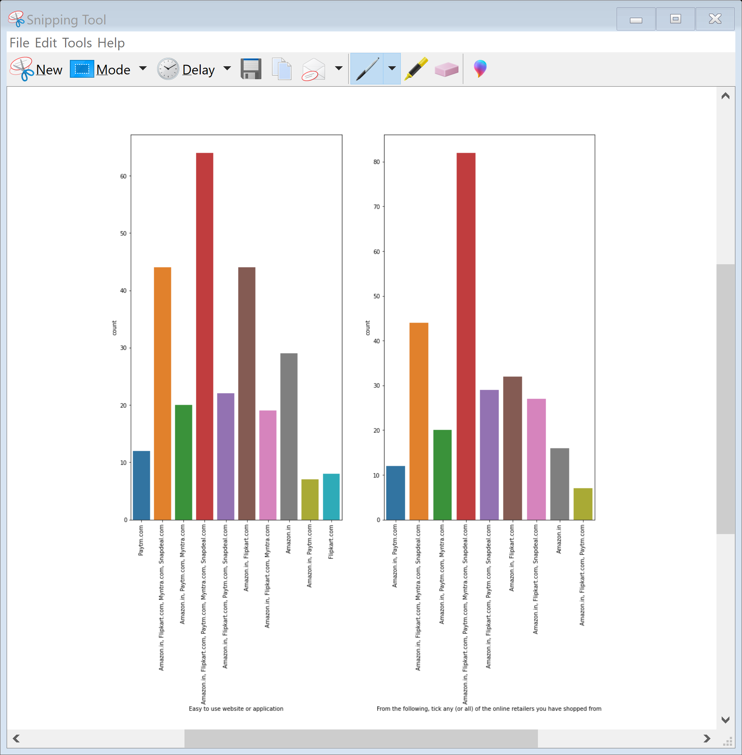
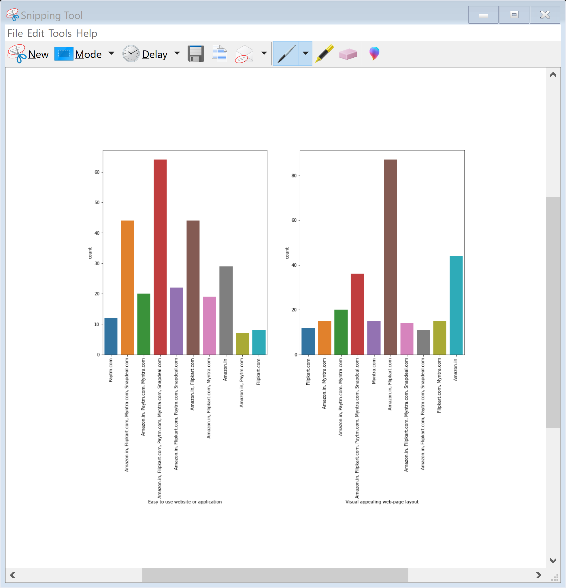
Most of the Users agree that doing online shopping give them value of money spend. Most of the User uses mainly ecommerce website Amazon.in , Flipkart.com , paytm.com , Myntra.com , snapdeal.com to shop online as these websites have a user frienly interface. Amazon.in , Flipkart.com , paytm.com , Myntra.com , snapdeal.com have a user frienly interface and are easy to use. Websites like Amazon and Flipkart have visual appealing webpage layout

Slide 15
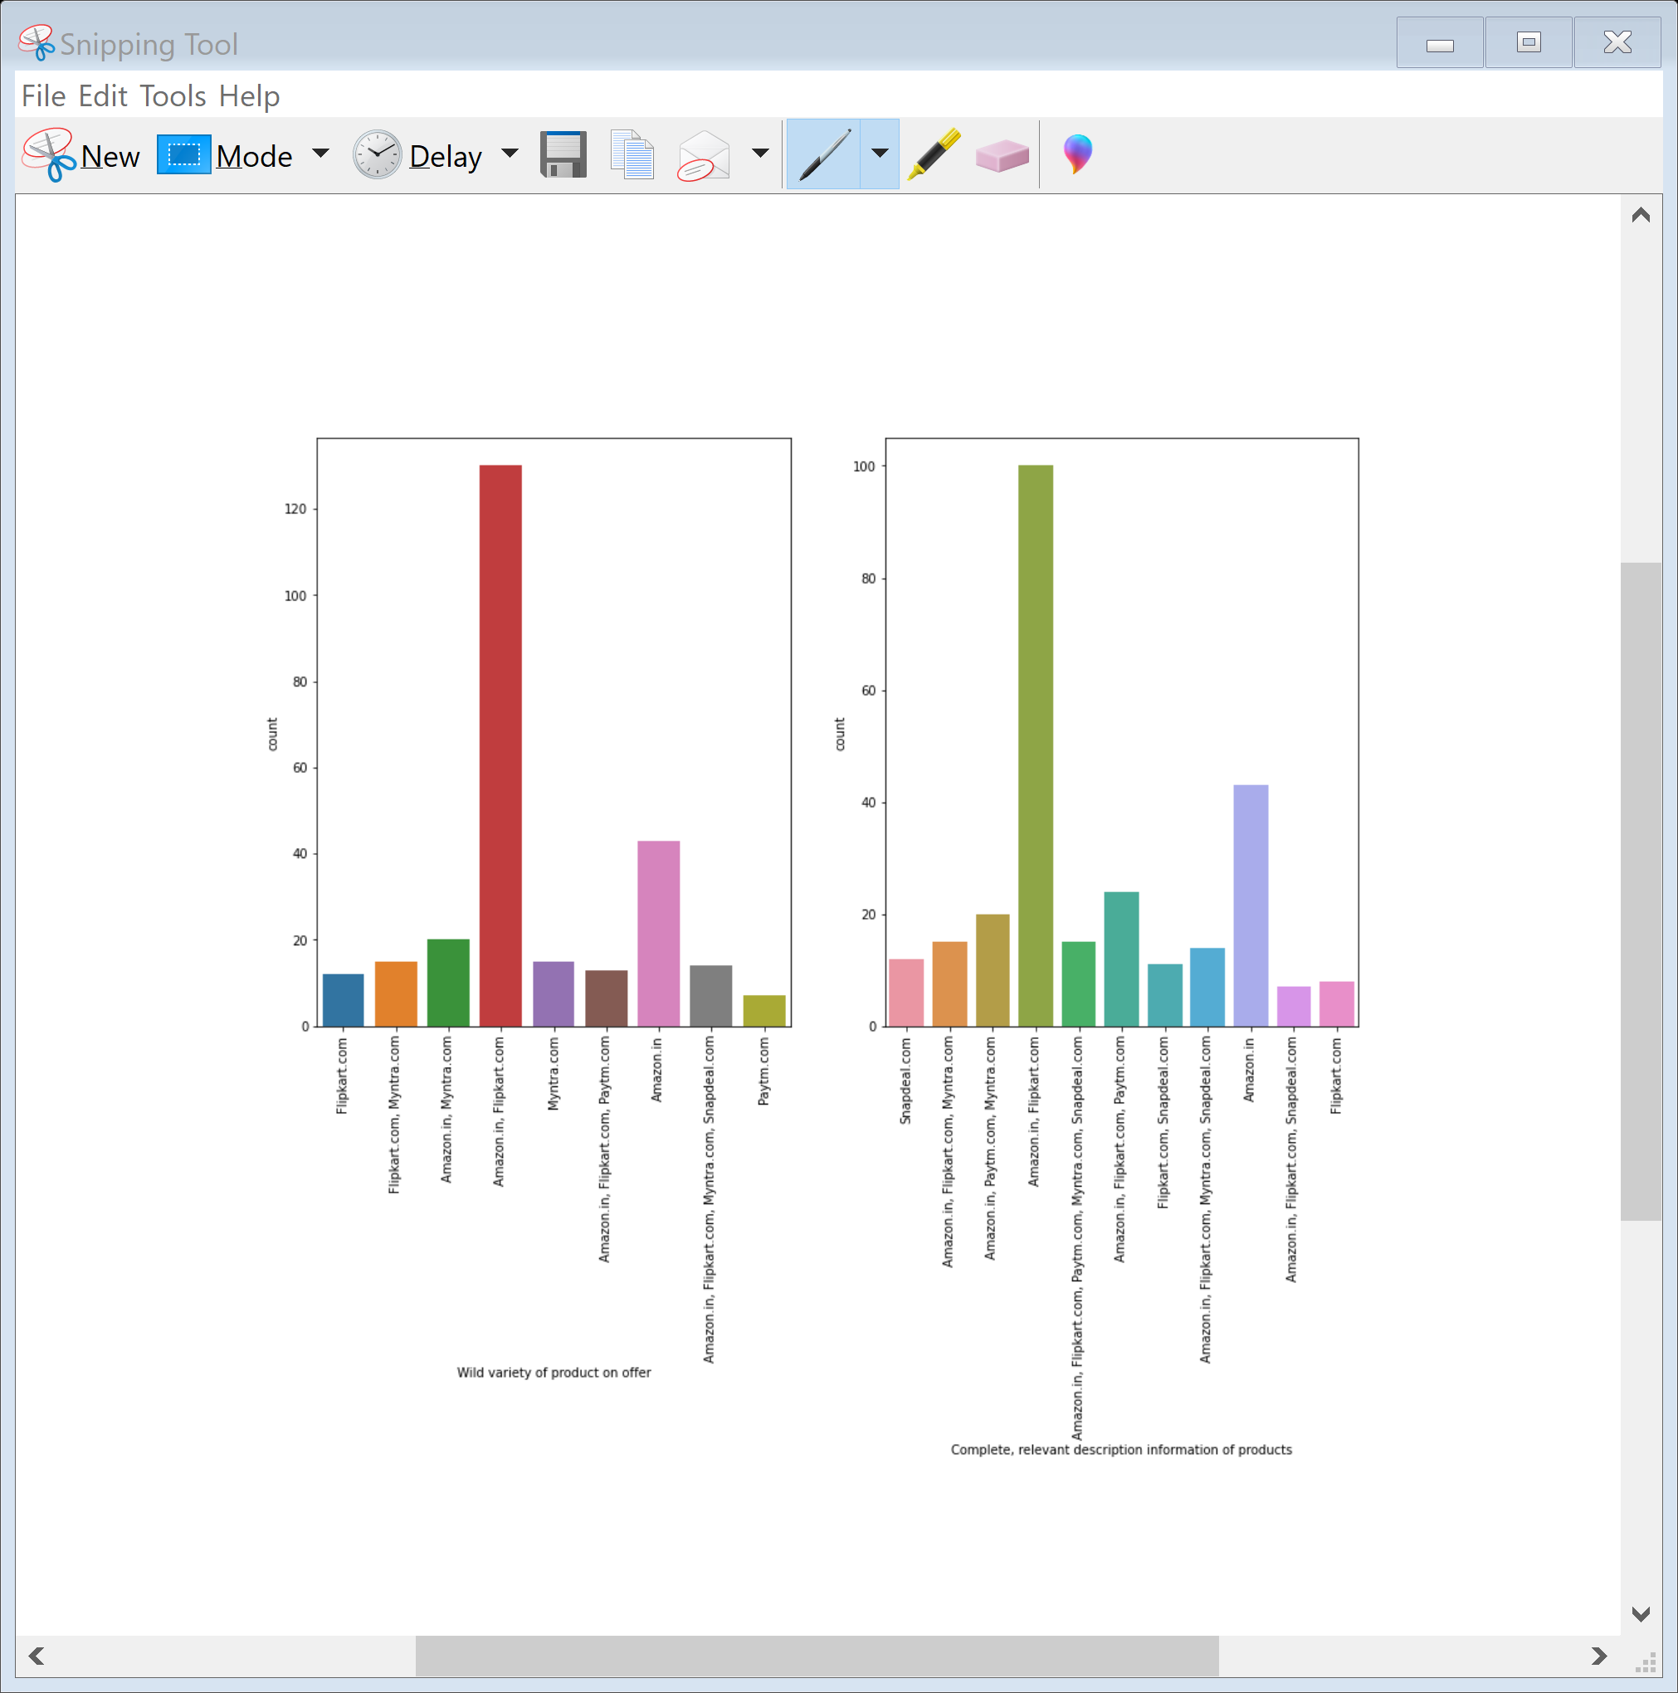
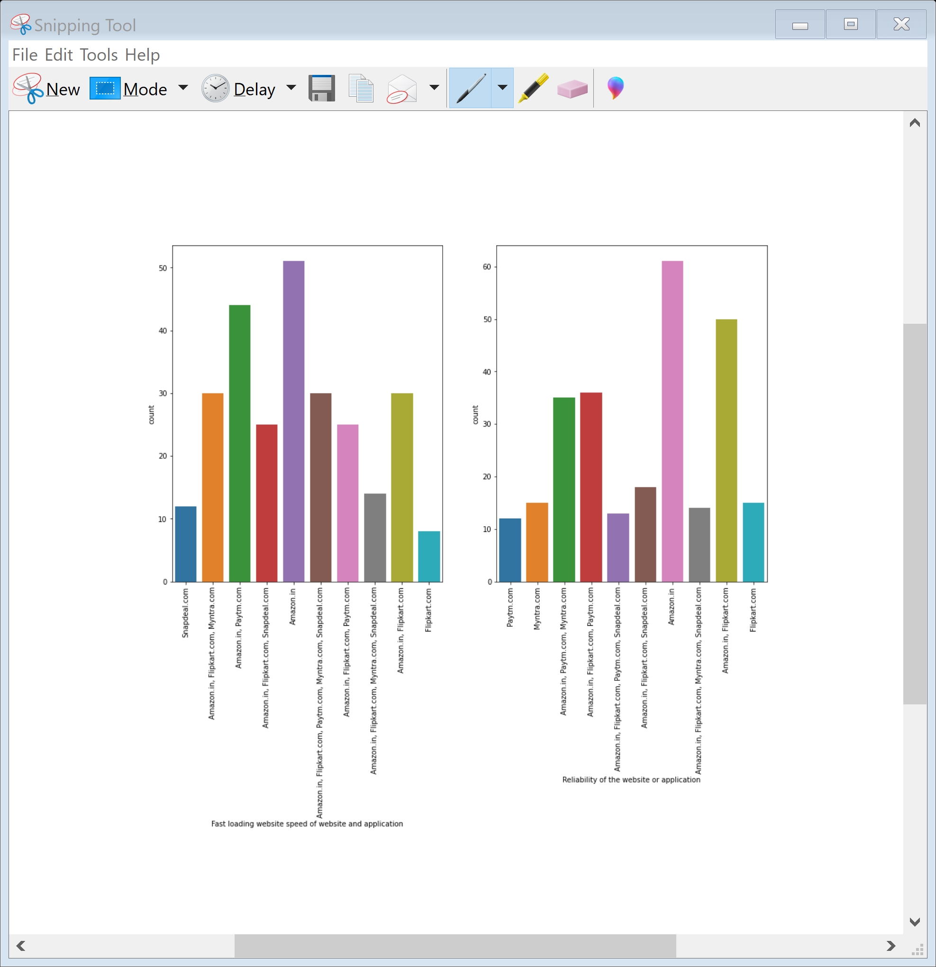
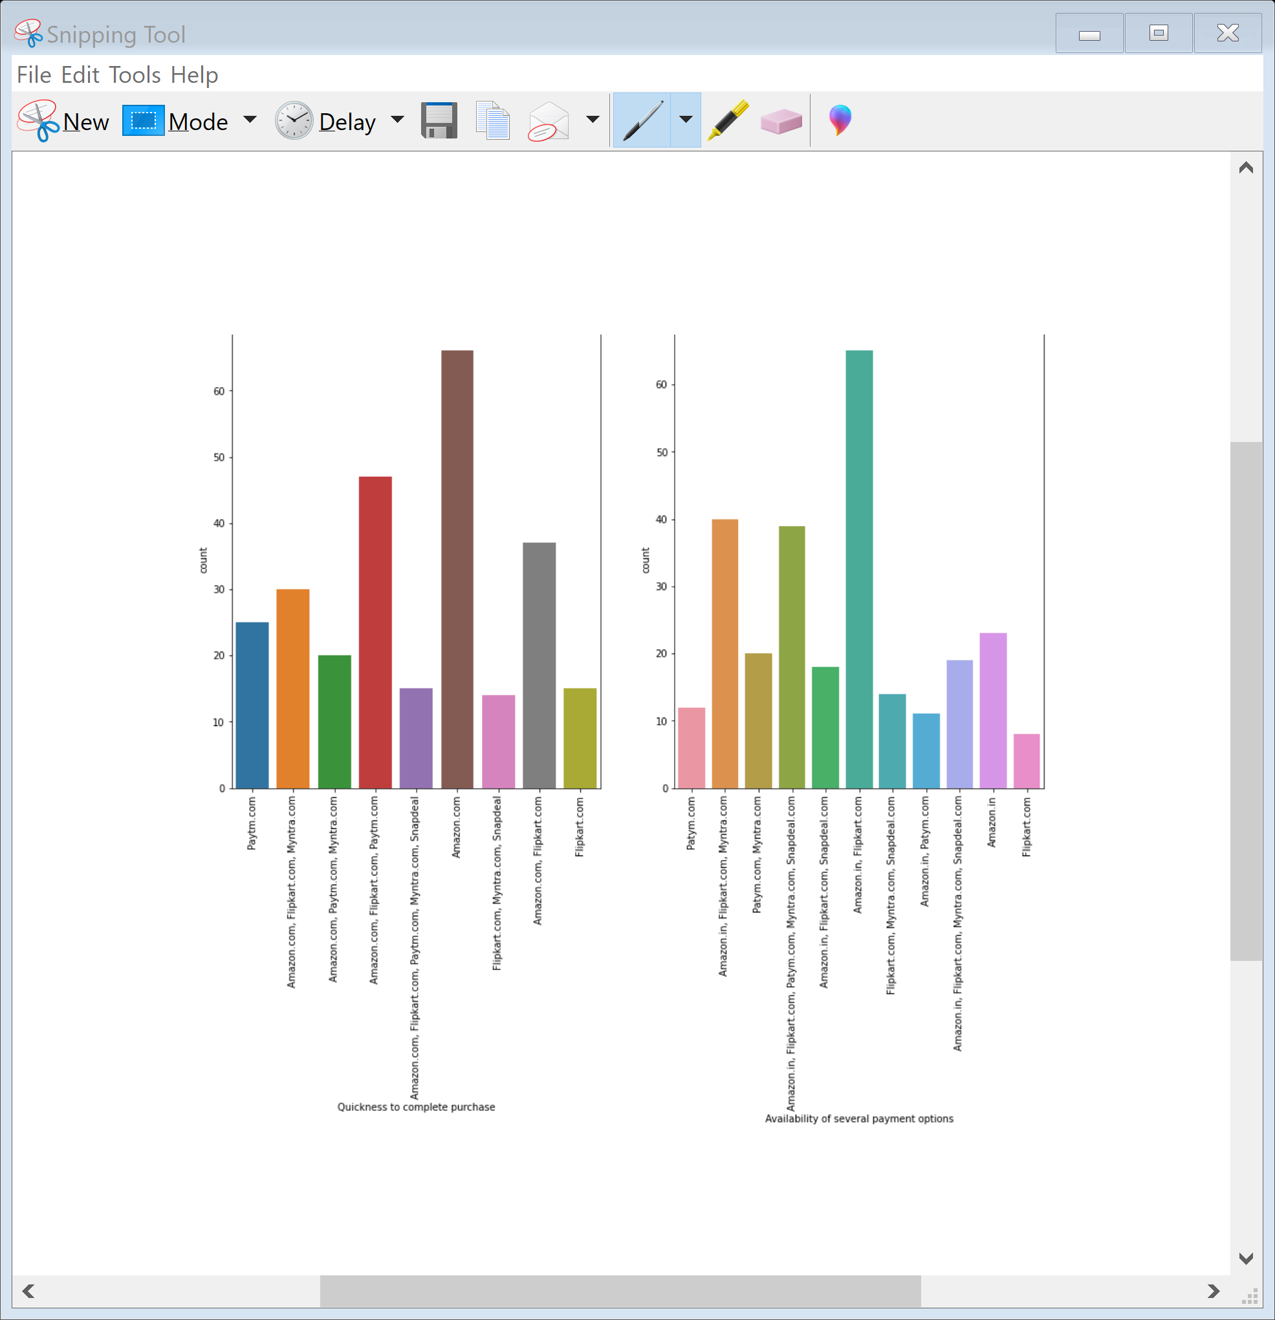
Website like amazon.in and flipkart.in have wide variety of products and gives complete, relevant description information of products. Amazon top the list of fast loading websites , reliability of the website and application application. Among all the e-commerce website Amazon provides quickness to complete the purchase. Among all the e-commerce website Amazon and Flipkart provides several payment options.

Slide 16
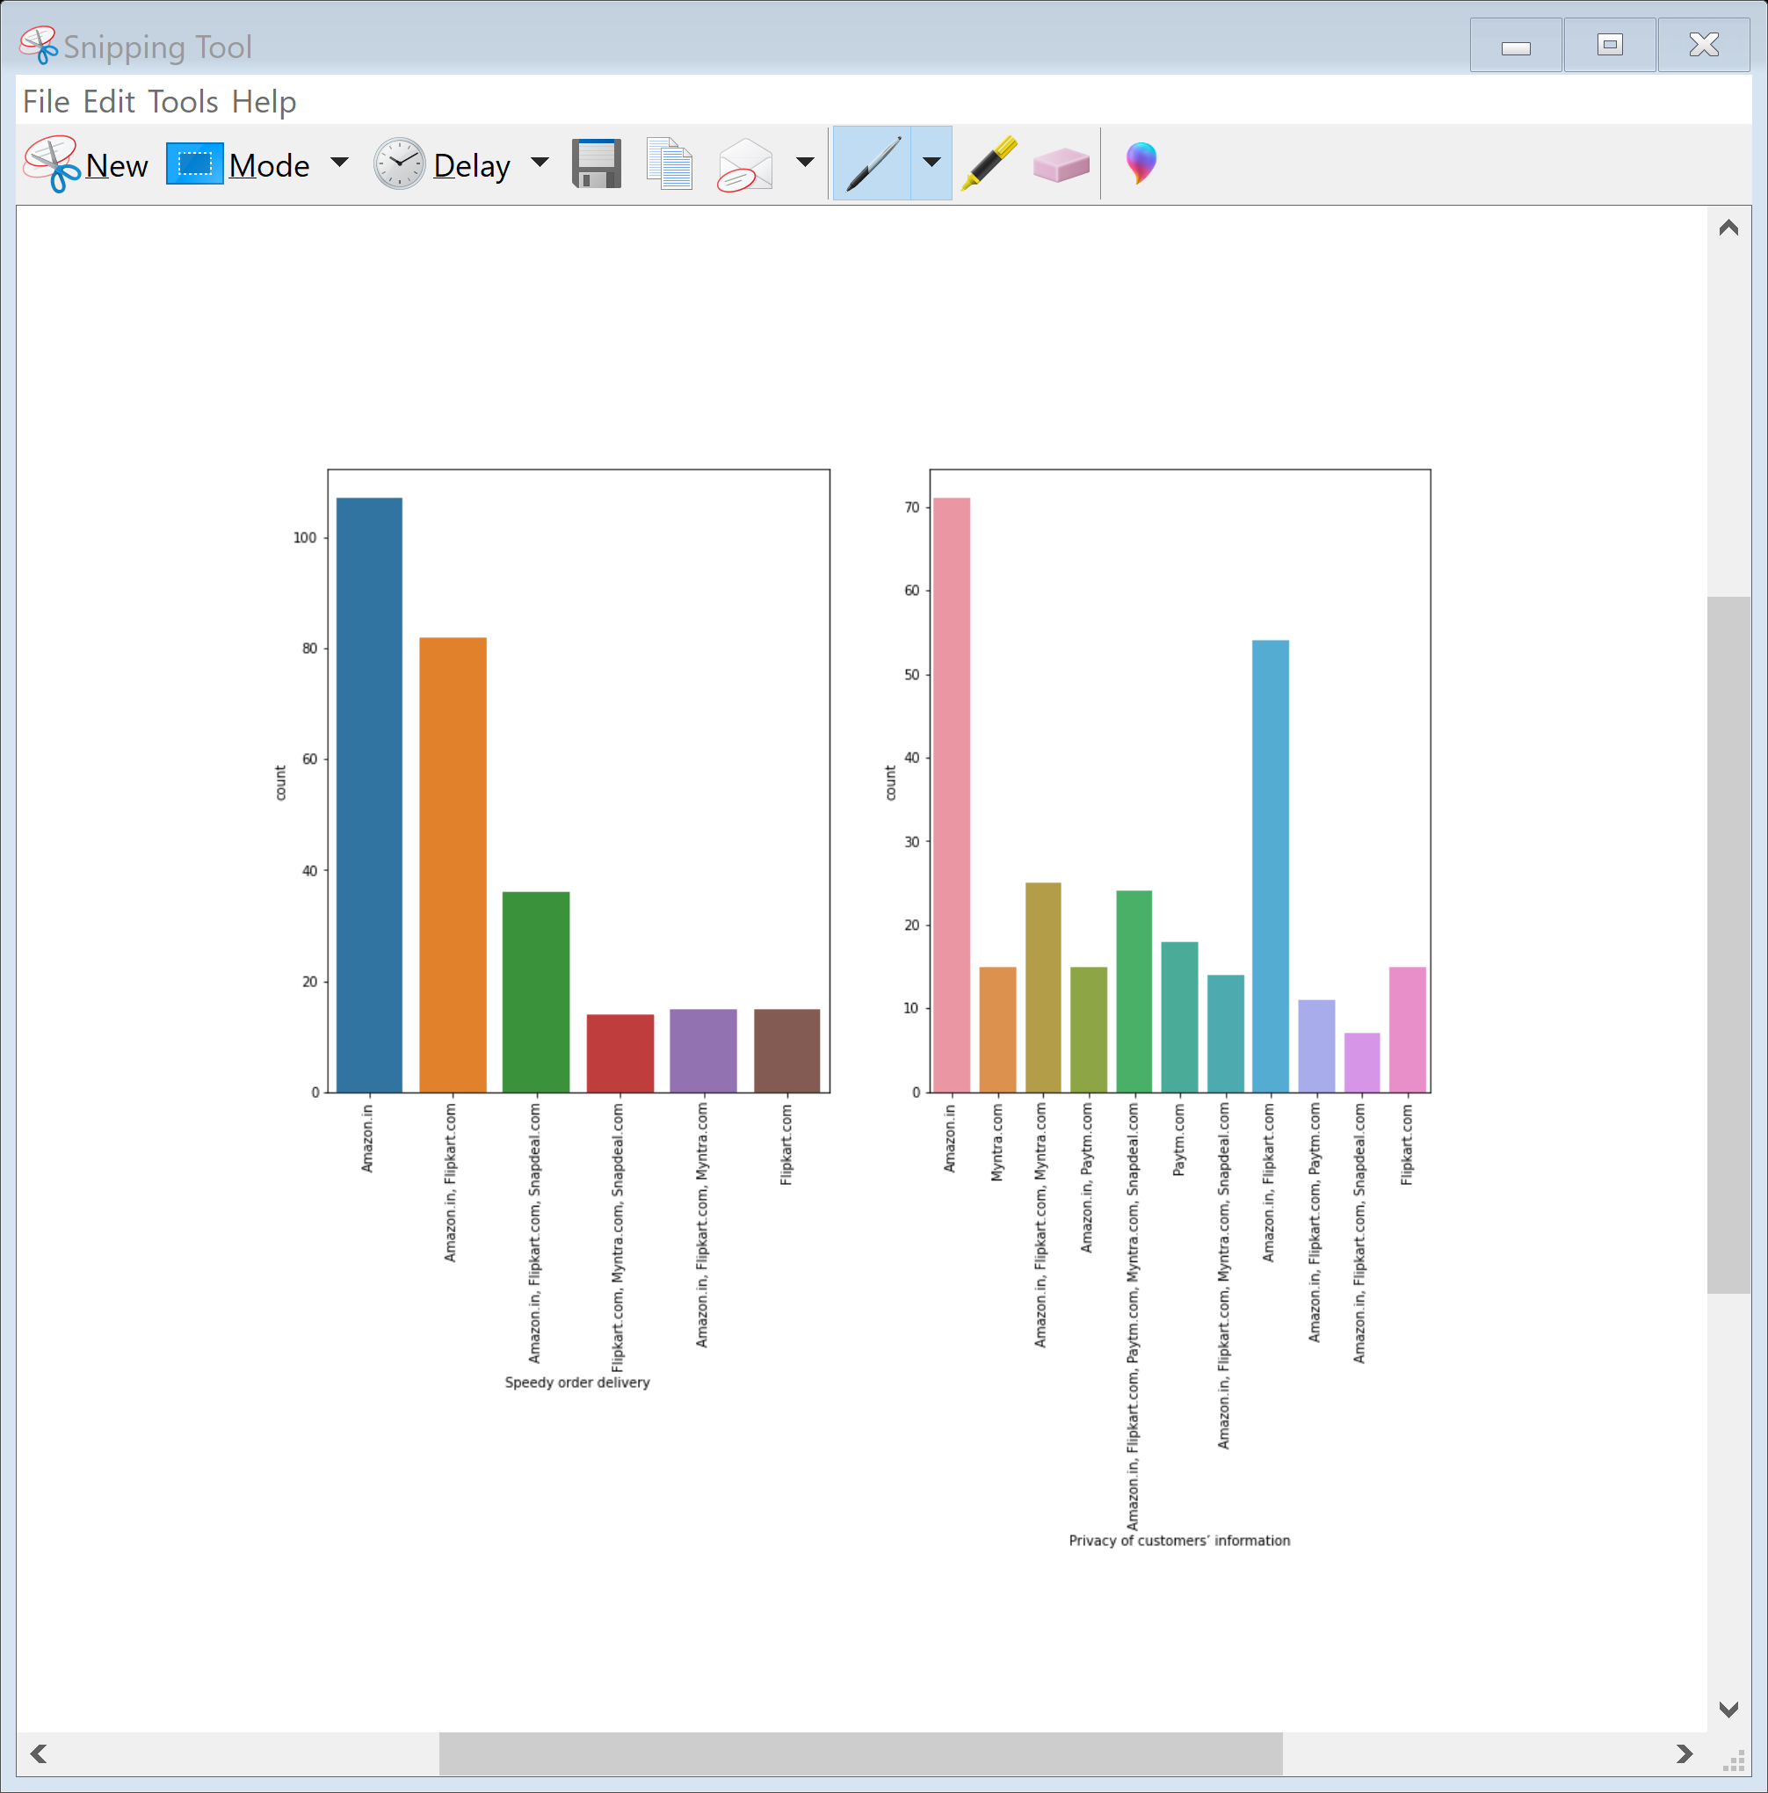
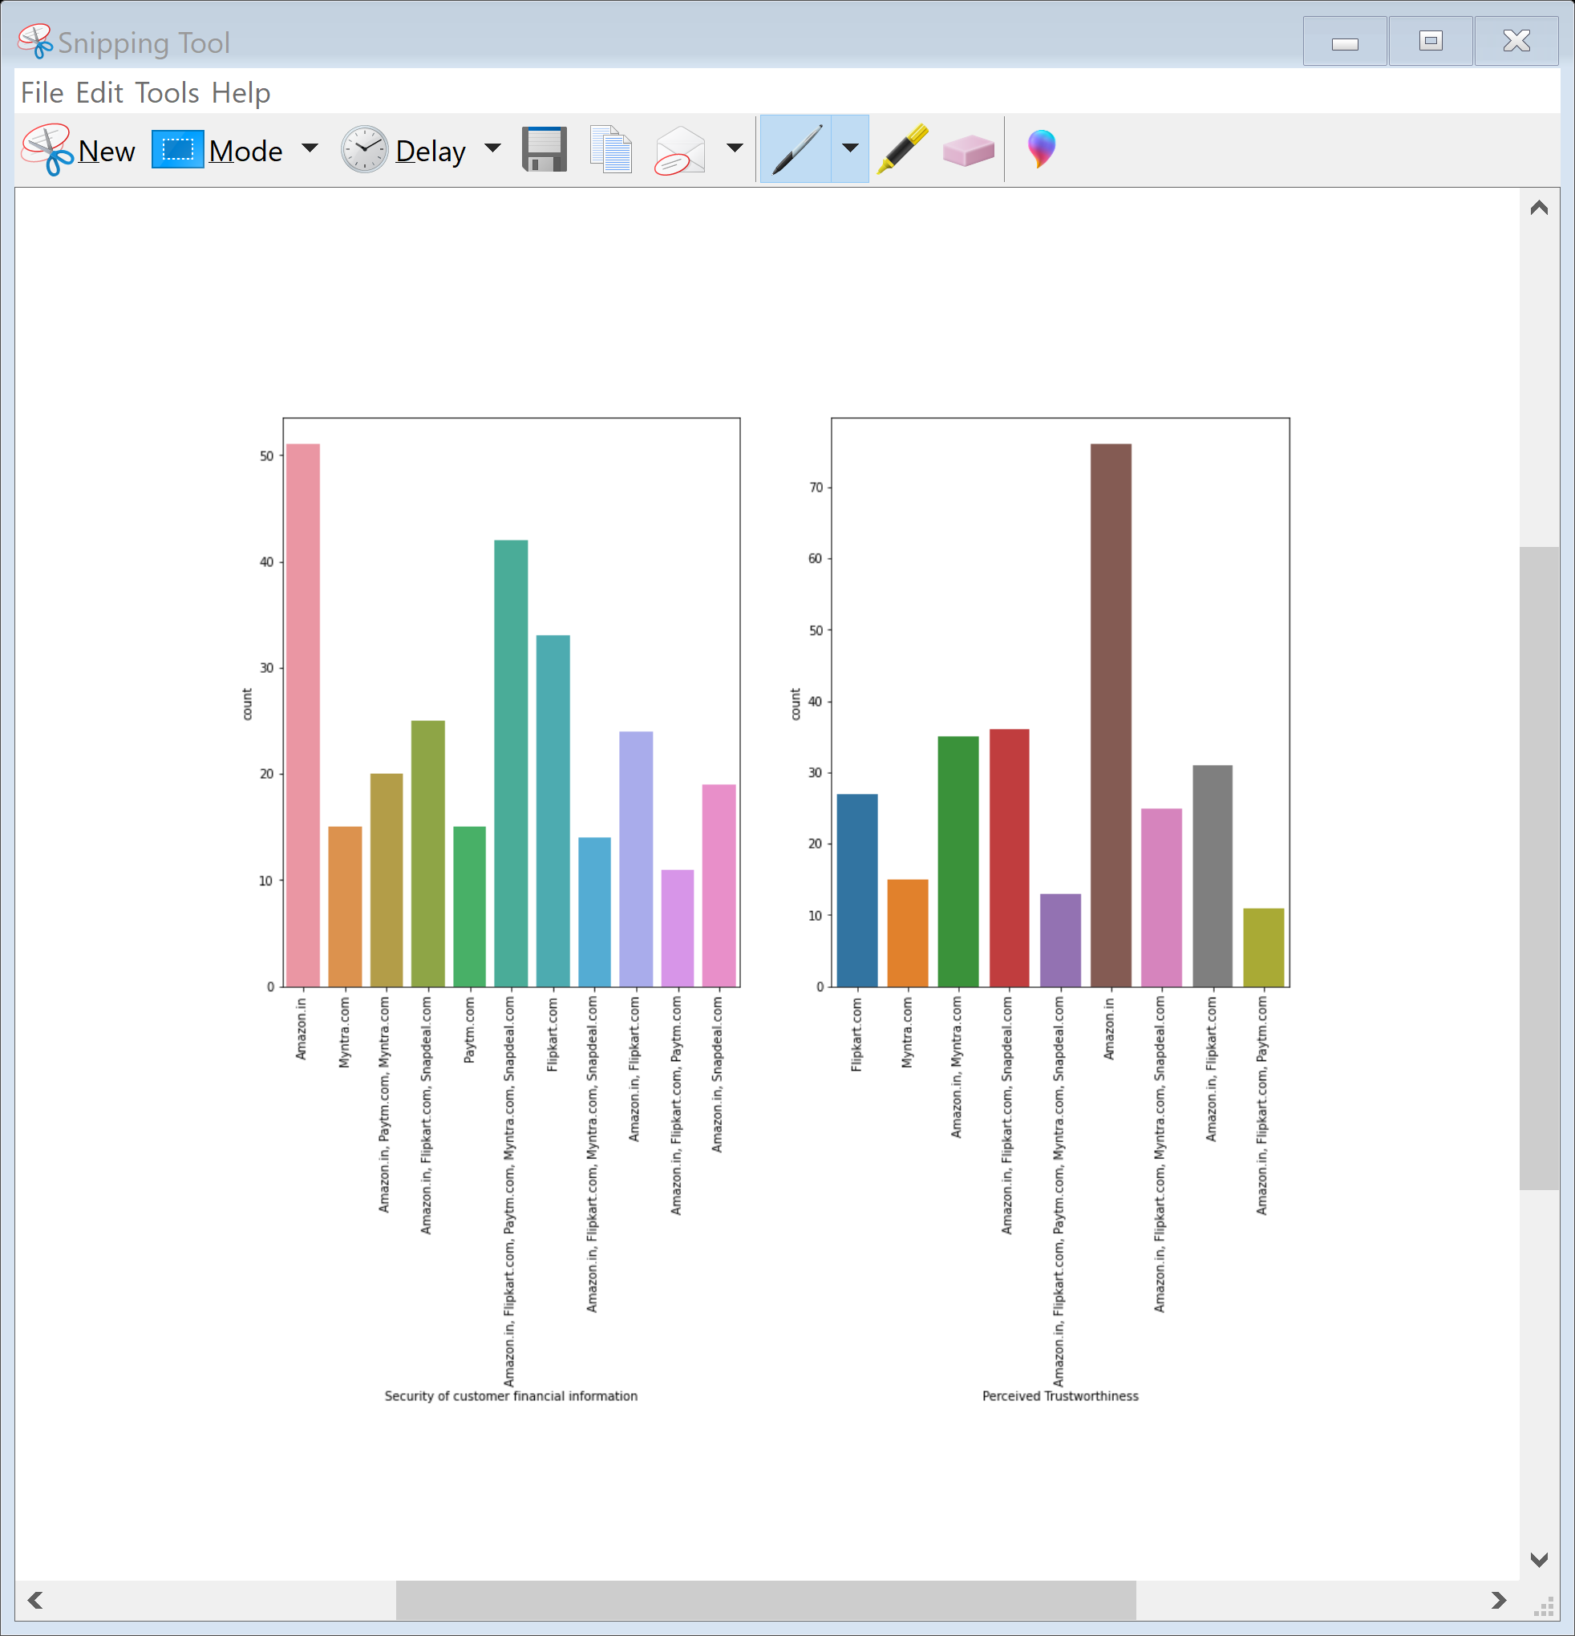
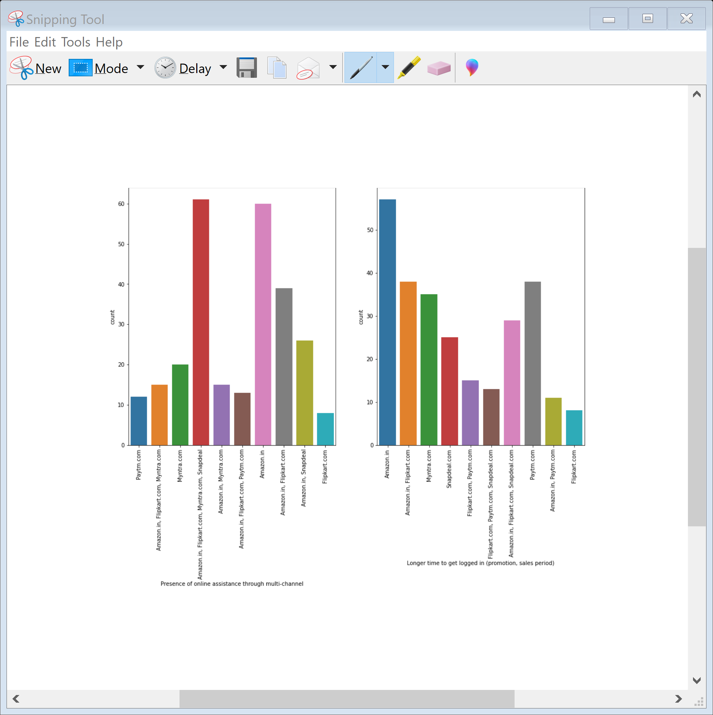
Among all the websites Amazon top the list of speedy order delivery and privacy of customer's information. Among all the websites Amazon top the list of security of customer financial information and Perceived Trustworthness. In Presense of online assistance through multi-channel wesbite amazon.in , flipkart , myntra and snapdeal topped the list. Among all the websites Amazon top the list of Longer time to get logged in (promotion, sales period)

Slide 17
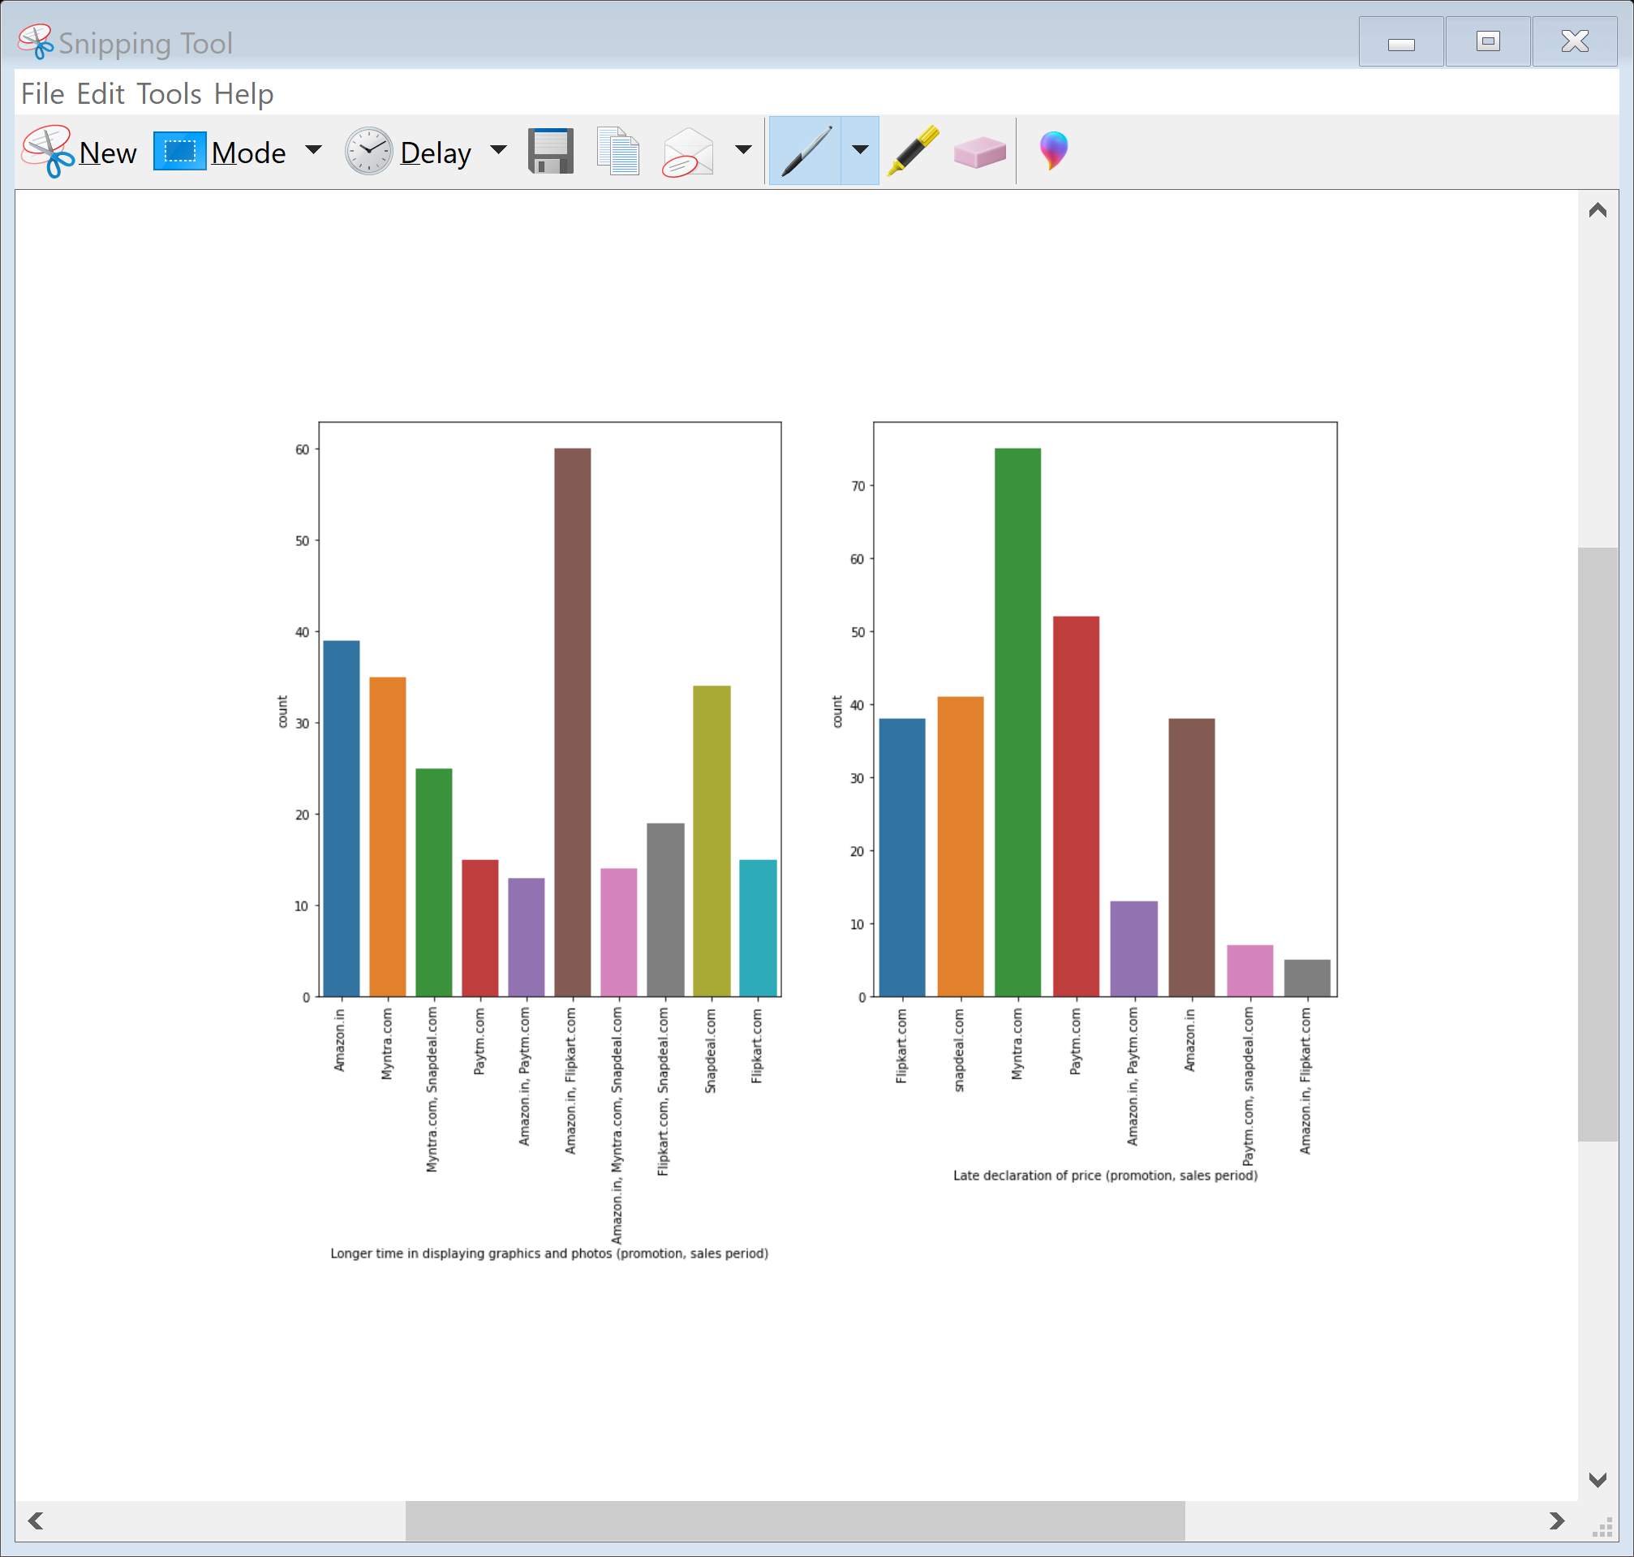
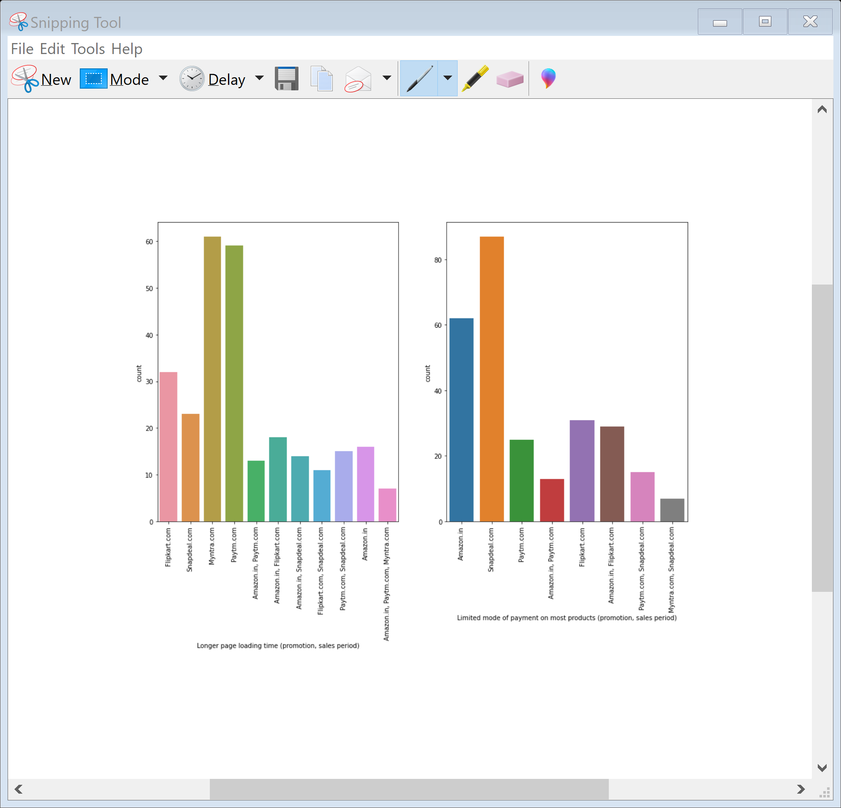
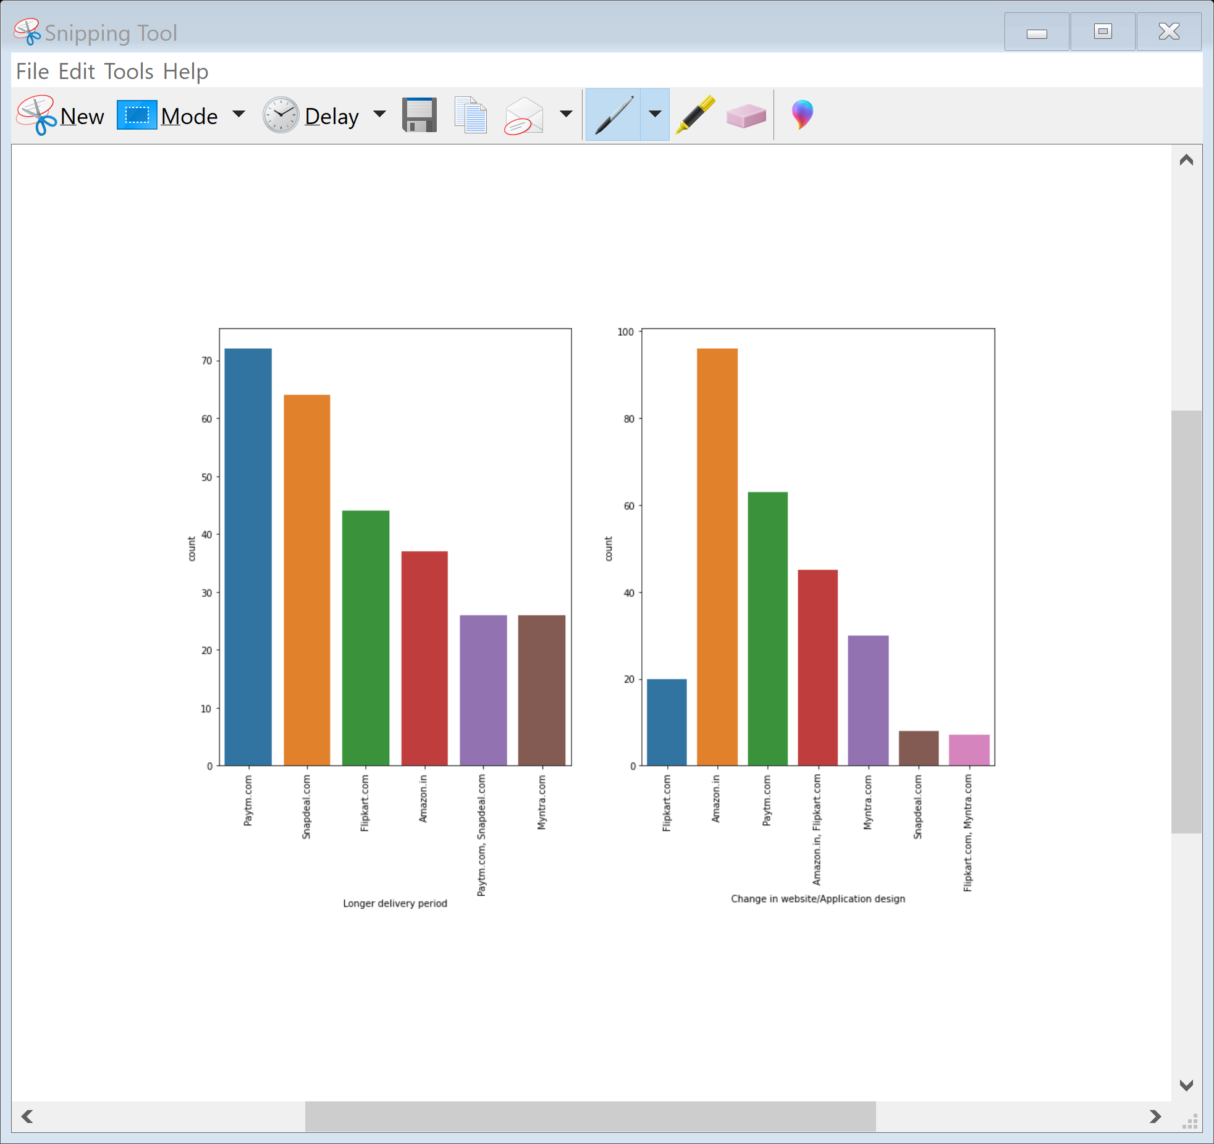
Longer time in displaying graphics and photos (promotion, sales period) amazon.in and flipkart.com topped the list. Among all the e-commerce website Myntra topped the list of Late declaration of price (promotion, sales period). Among all the e-commerce website Myntra topped the list in Longer page loading time and snapdeal topped the list of Limited mode of payment. Among all the e-commerce website paytm topped the list in Longer delivery period and its a negative sign for any e commerce website. Among all the e-commerce website amazon.in topped the list in Change in website/Application design.

Slide 18
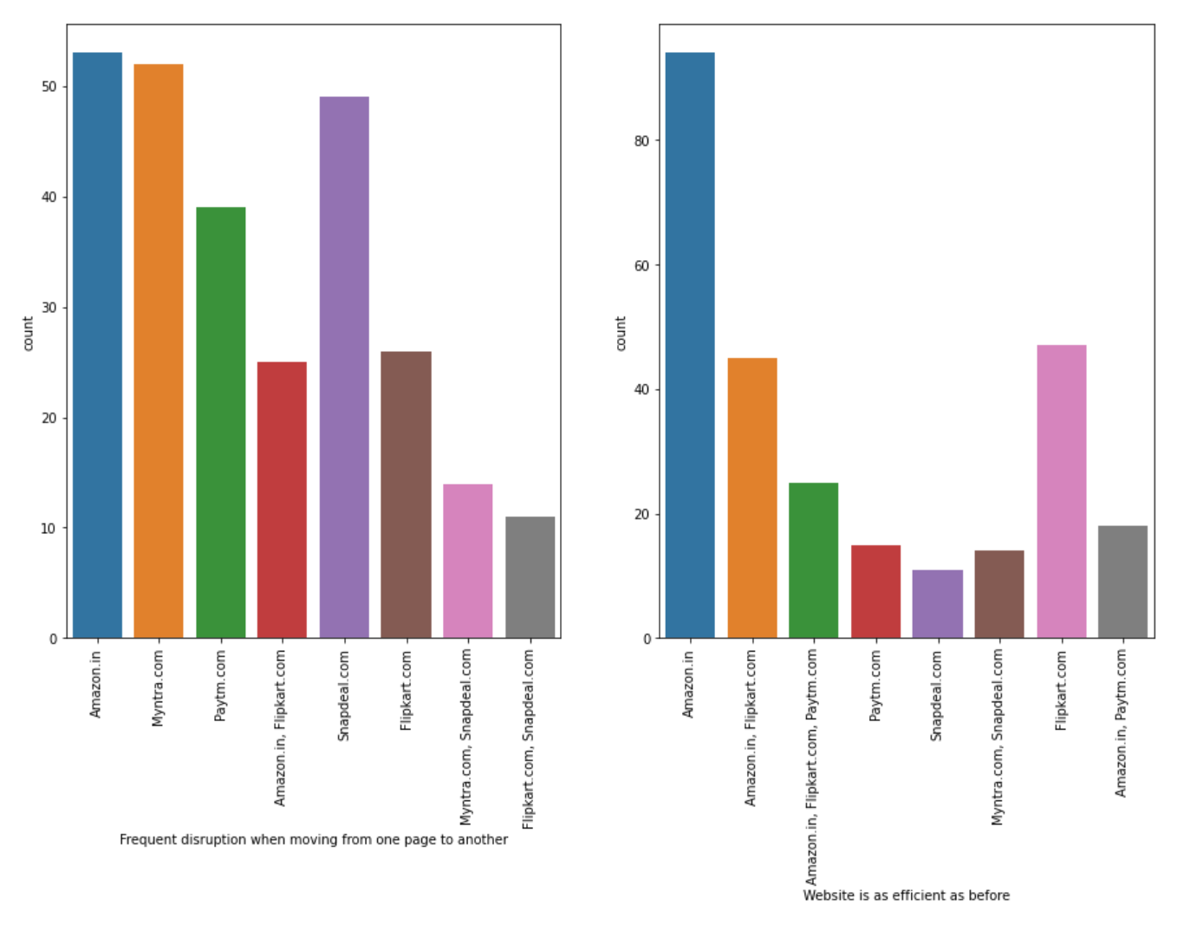
Among all the e-commerce website amazon.in topped the list in Frequent disruption when moving from one page to another and Website is as efficient as before

Slide 19
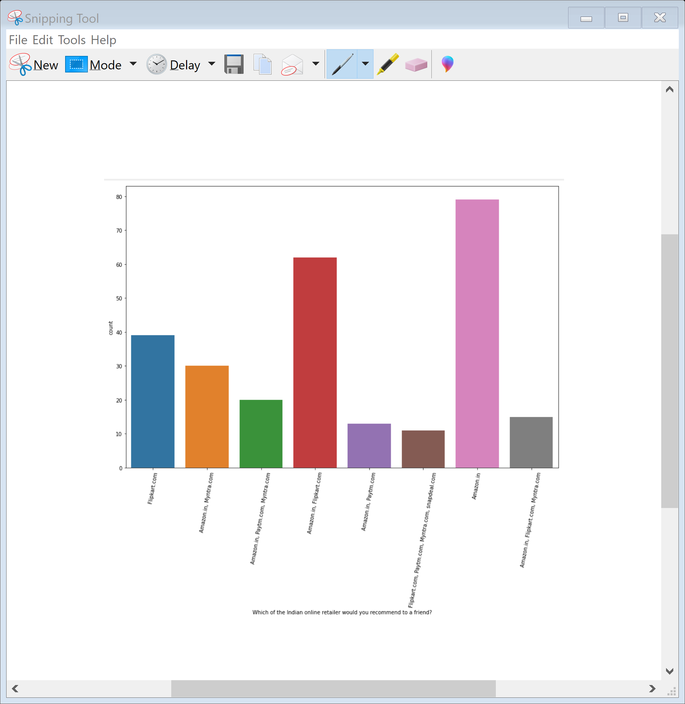
Final conclusion
As in the final countplot in which user were asked which online retailer they would recommend to a friend. Most of the respondents says Amazon.in because it is providing all the features that users want. Website is efficient and it is fast loading , It give complete , relevant description and information of products . It is reliable and quick to complete the purchase. Amazon give speedy delivery to its customers and their is several payment option avaliable on the website. It provide online assistance through multi channels.Providing good deals on products. Amazon have a user friendly interface and has visual appealing webpage layout. Amazon also offers wide variety of products and its application is easy to use . lastly the main thing why user recommend it is because of its Trustworthiness and also its robust Security in protecting customer financial information and their Privacy information .
They are some cons like the amazon website topping the list In Frequent disruption when moving from one page to another this con company should see and improve it to give overall best experience to the users.

